Slide 1
Cookies, Sessions, Context

Slide 2
Cookie
a small amount of data that we can associate with a user
every time the user comes back to our site
that cookie is persistent
it stays between repeat visits to our site
“a database stored on the user’s computer that’s passed with every request”
cookies are a tool for us as web developers
we can use cookies to know if we’ve seen the same user before
makes it possible for us to implement logins / sessions
cookies are the most common way to implement sessions
in Europe you have to notify your user that you’re using cookies
you can see cookies in your chrome browser
under dev tools under resources

Slide 3
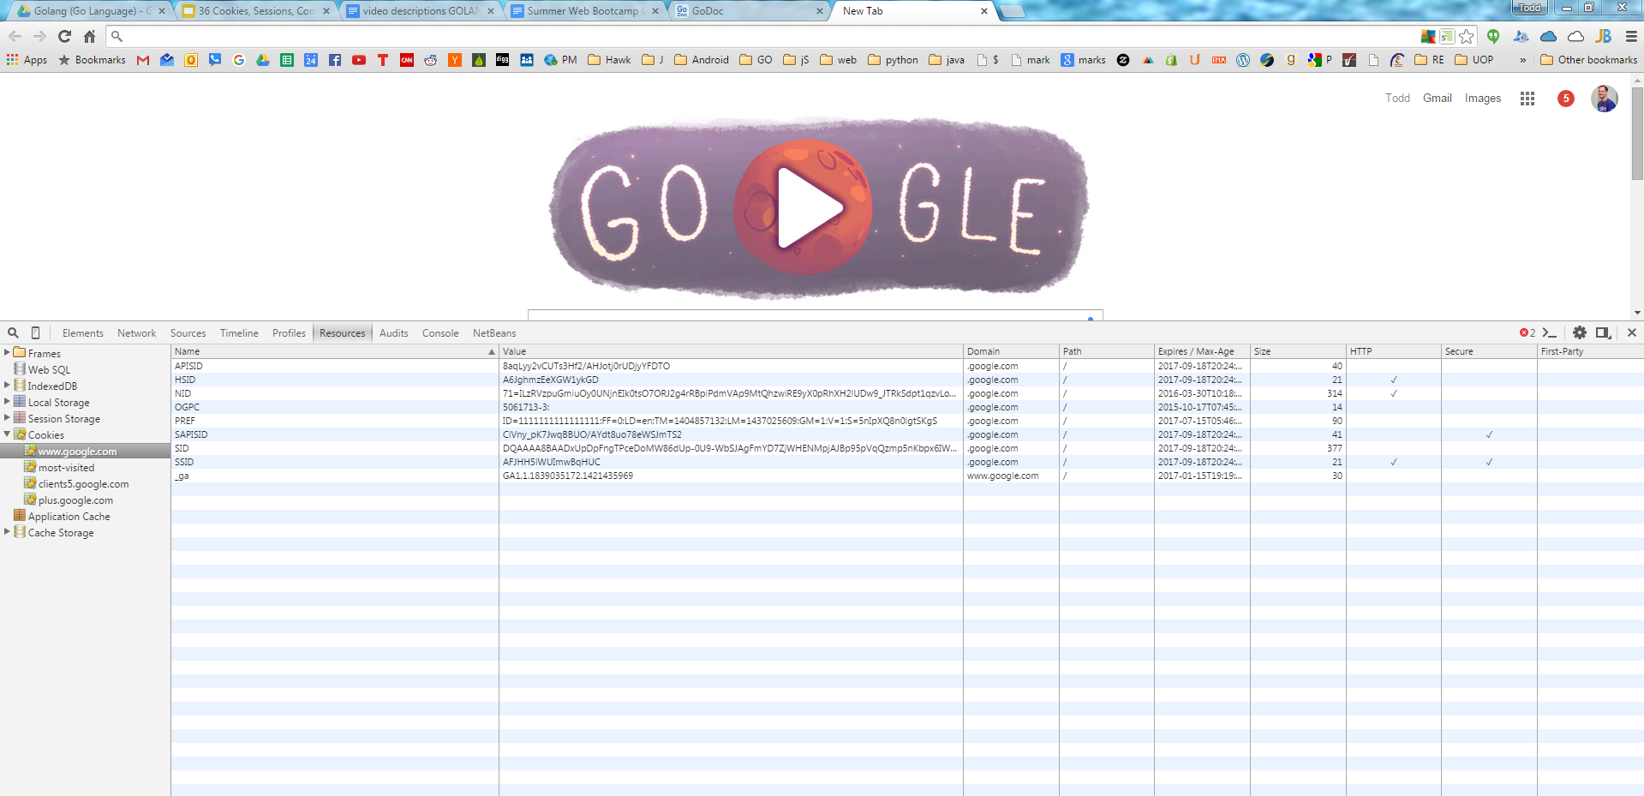

Slide 4
Cookie
every time a user goes to a domain
if there is a cookie from that domain on the user’s computer
that cookie is sent along with the user’s request to that server
the server can use this information to know the user’s identity

Slide 5
set cookie

Slide 6
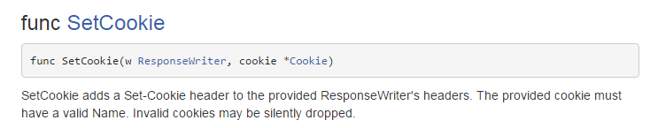
a cookie is a header

Slide 7
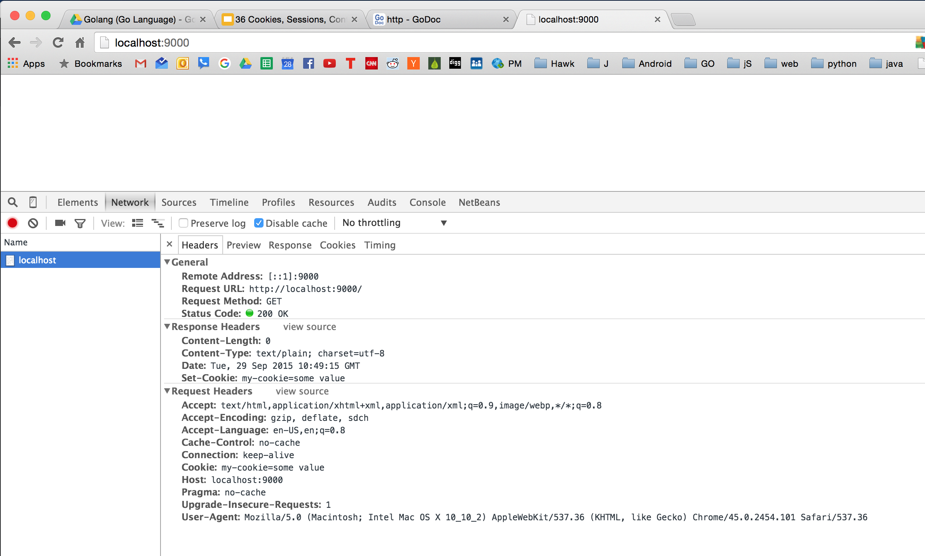

Slide 8
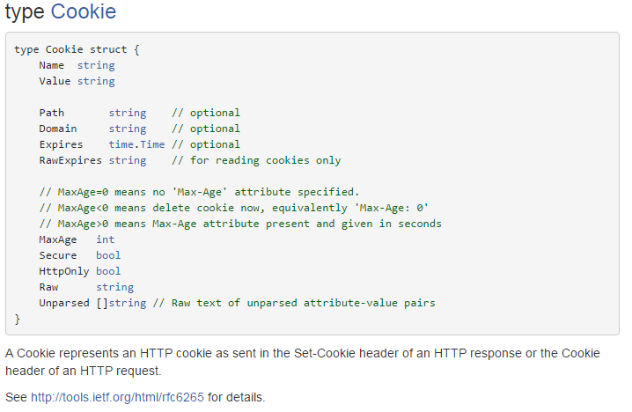

Slide 9
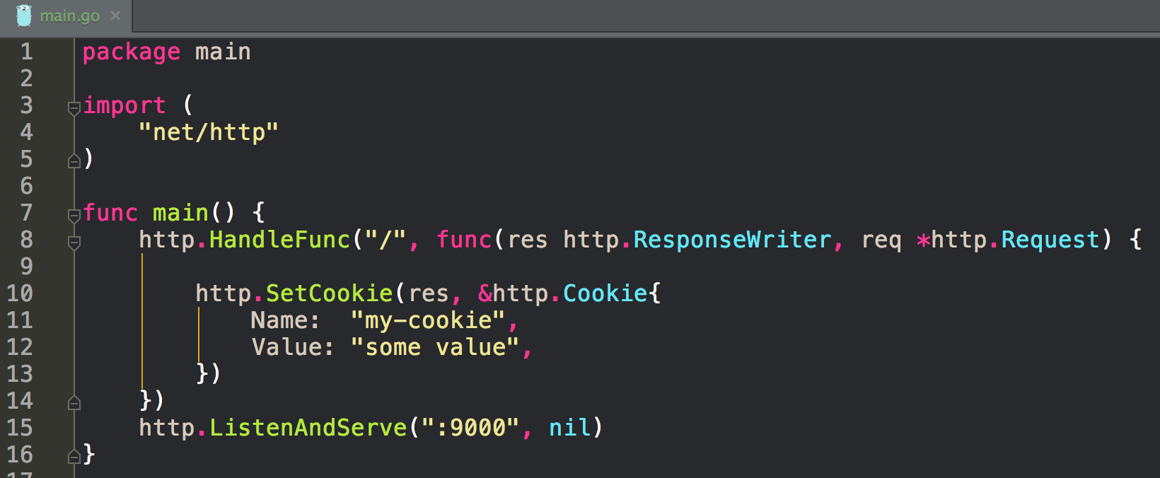
SET COOKIE

Slide 10
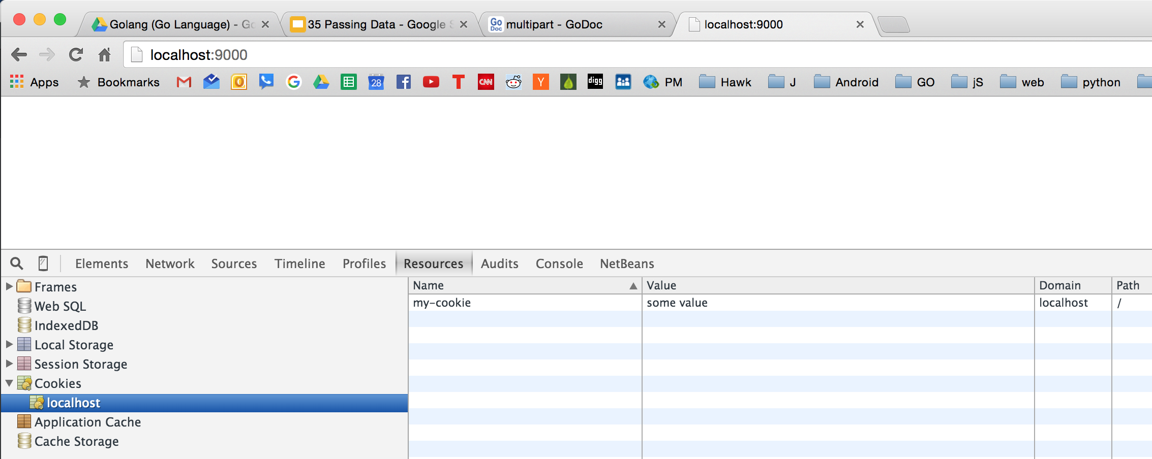

Slide 11
get cookie

Slide 12
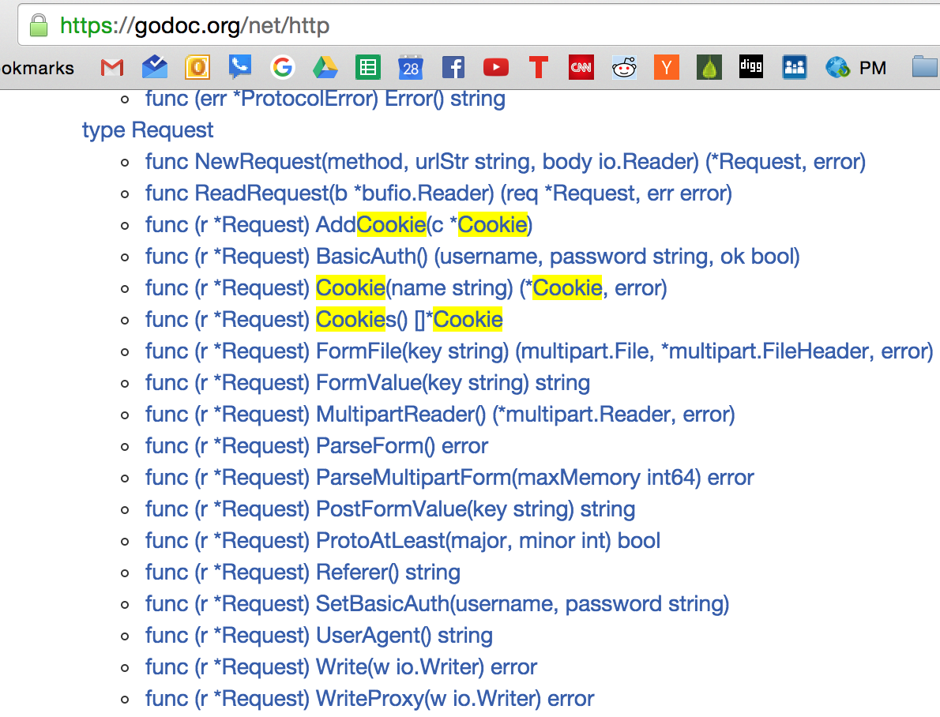

Slide 13
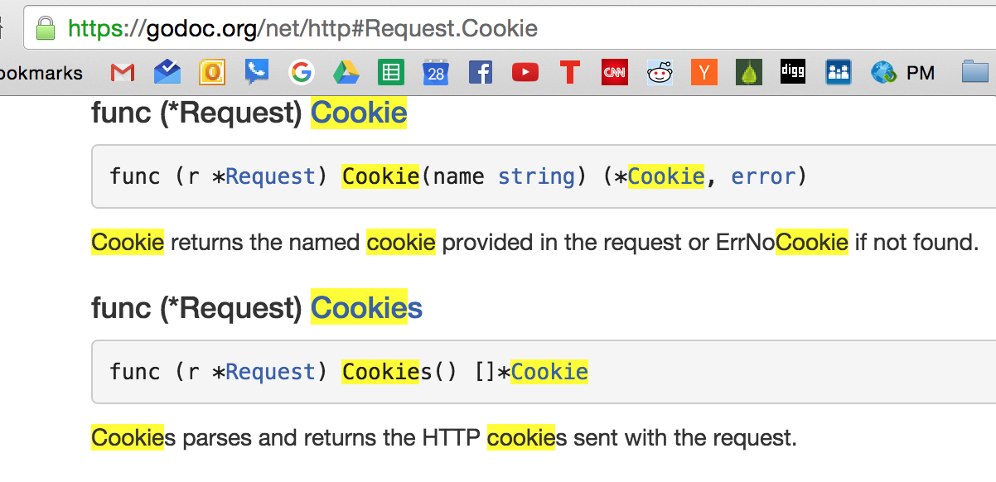

Slide 14
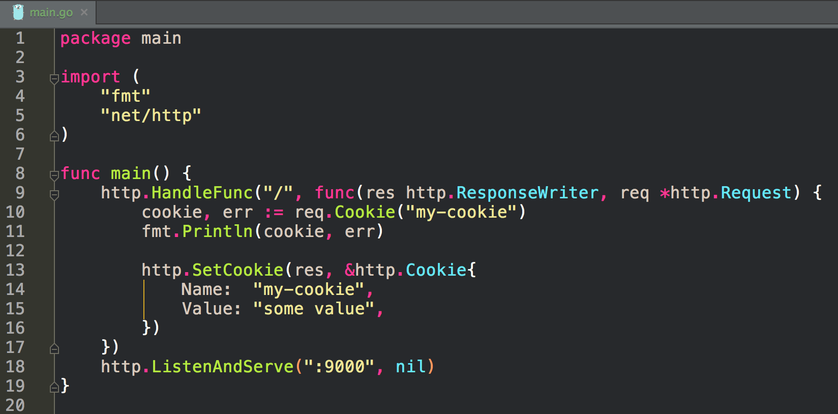
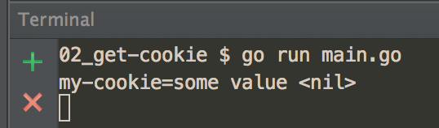

Slide 15
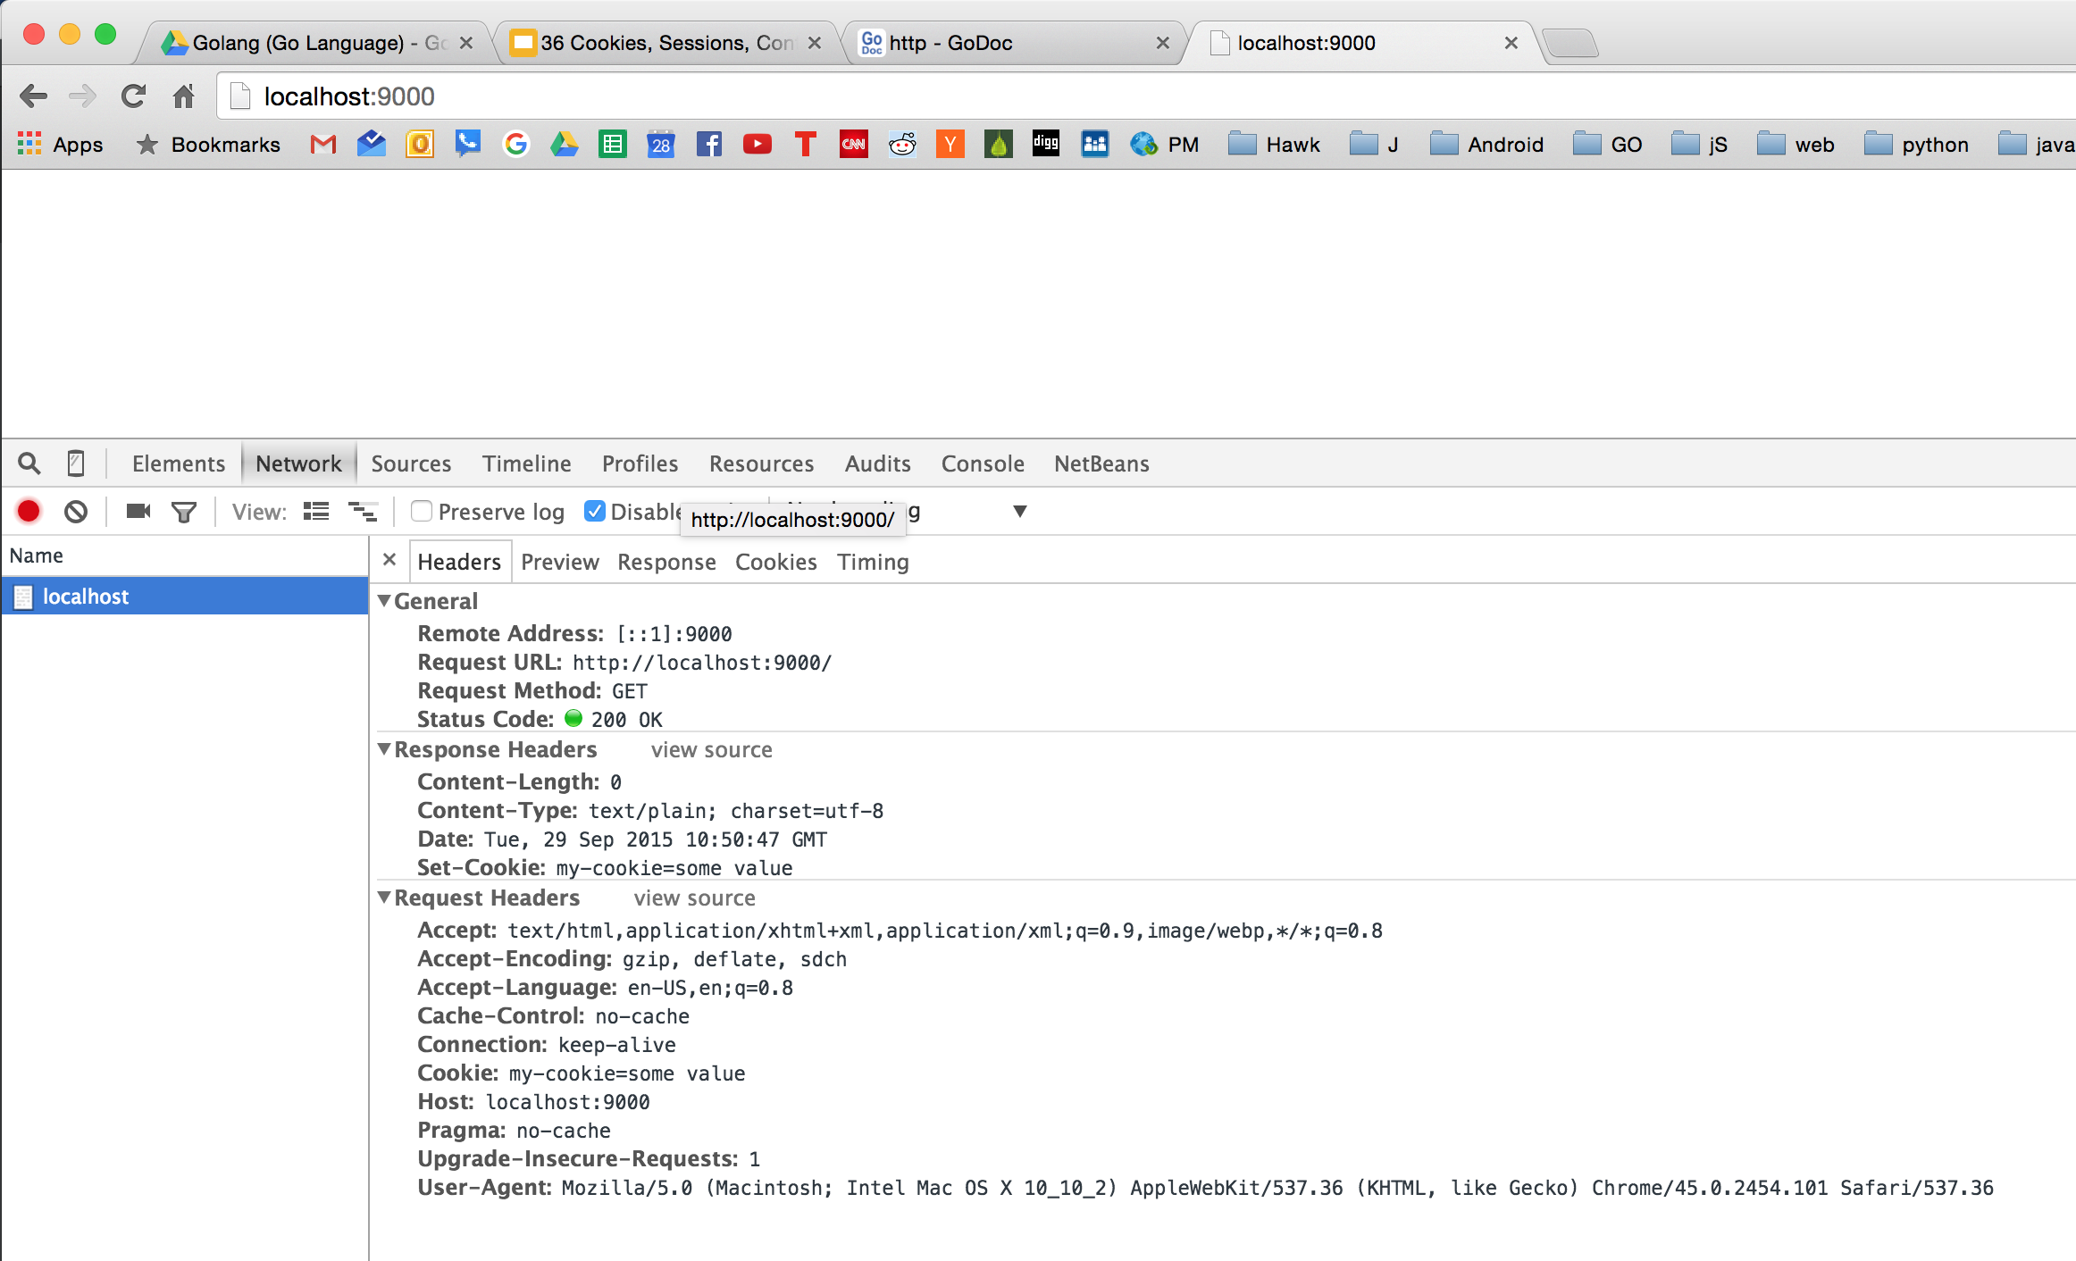

Slide 16
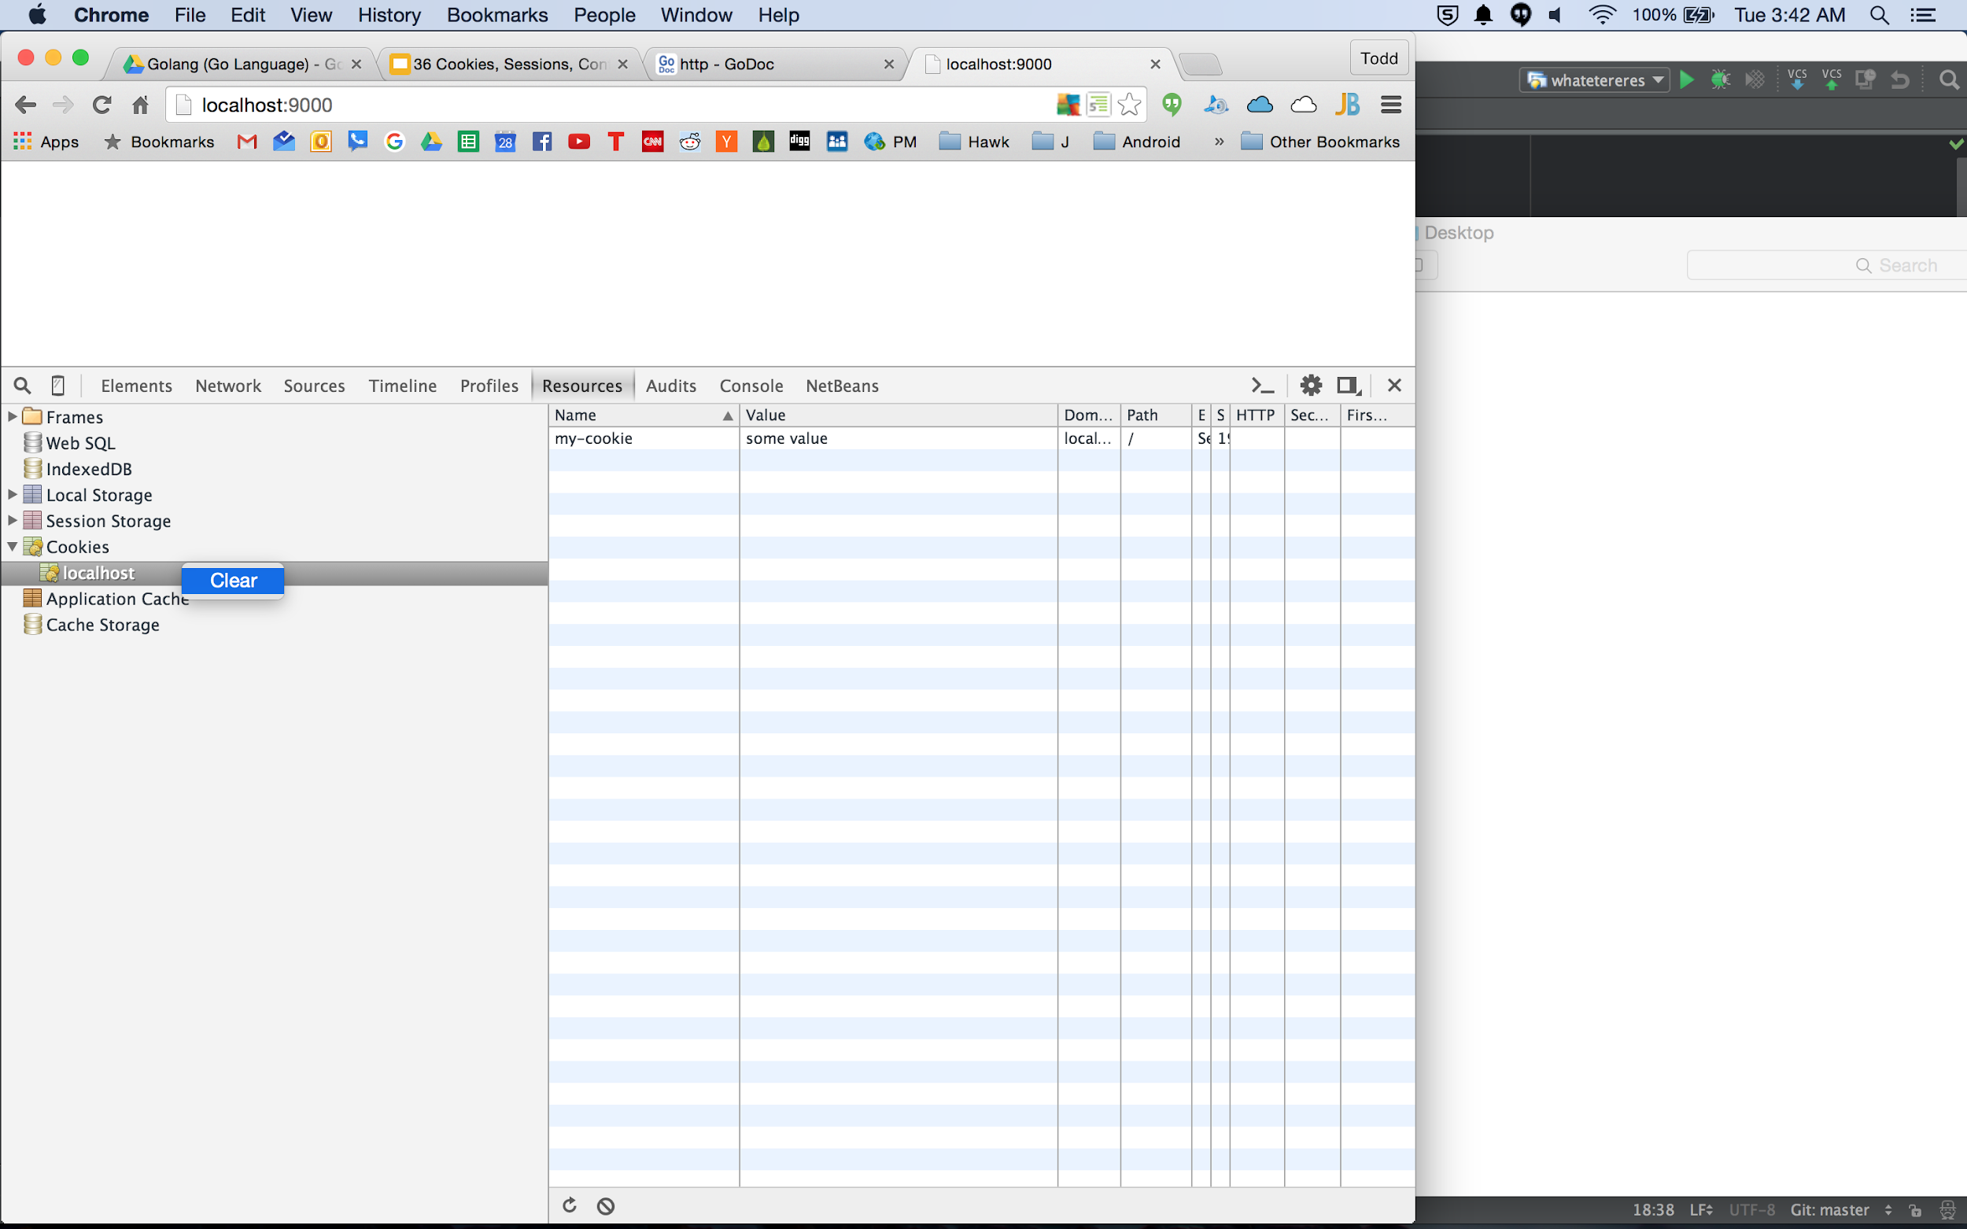
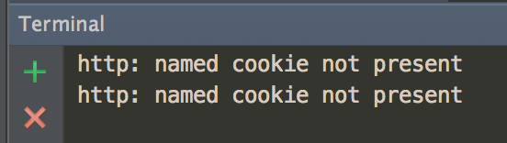

Slide 17
sessions
creating a UUID & setting it in a cookie

Slide 18
Sessions
a user logs in
until they log out, that’s their session
sessions create “state”
we want to know a user is logged in for each of their requests
UUID
universally unique ID
find a package
go-search.org
godoc.org

Slide 19
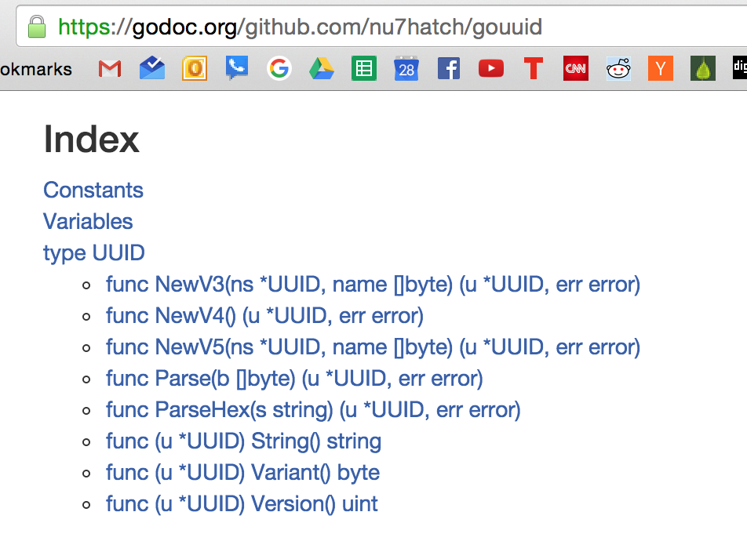

Slide 20
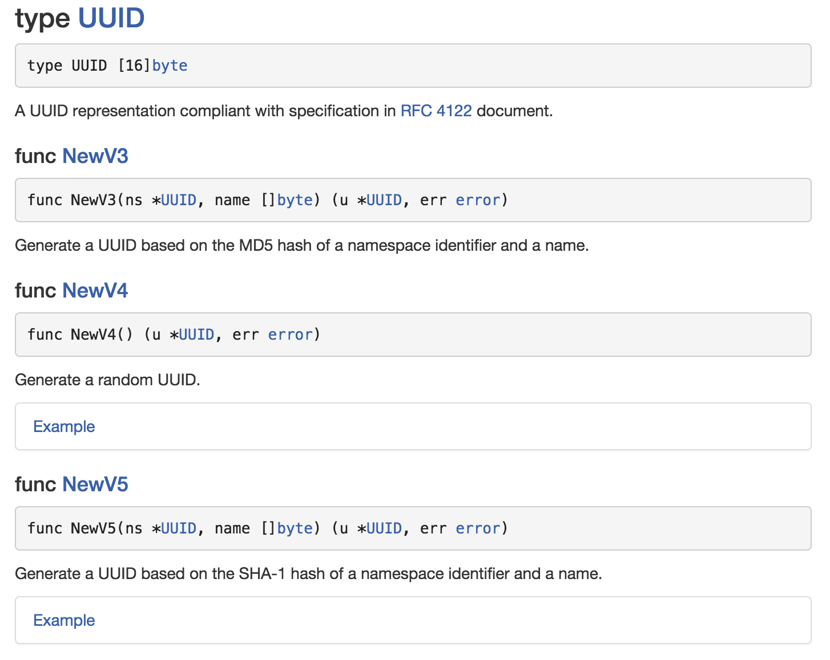
The one we want

Slide 21
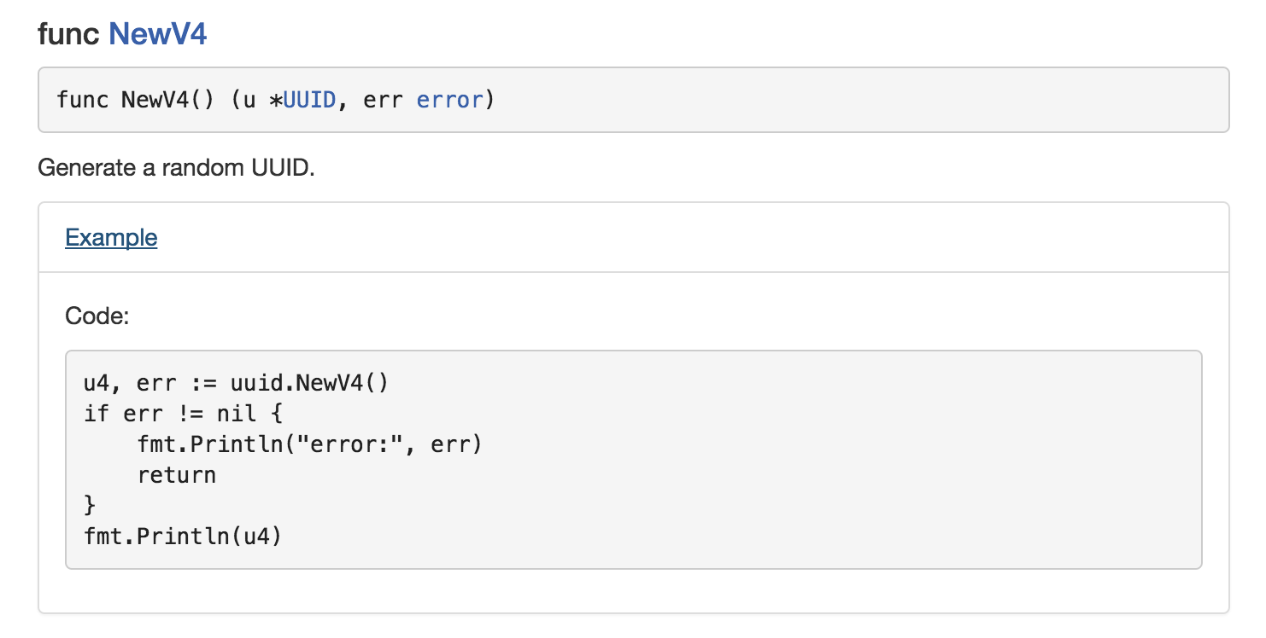

Slide 22
go get github.com/nu7hatch/gouuid

Slide 23
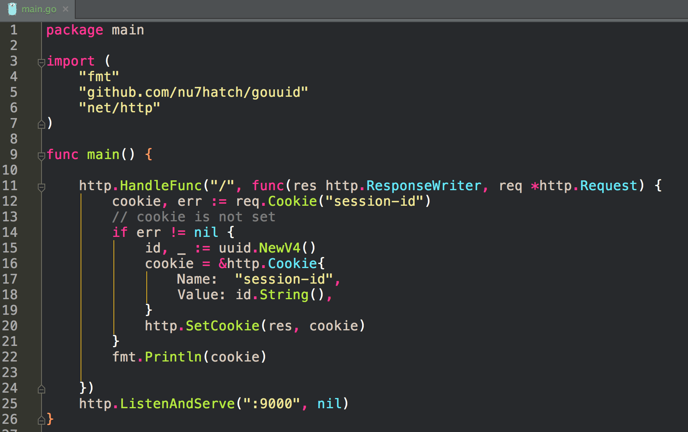

Slide 24
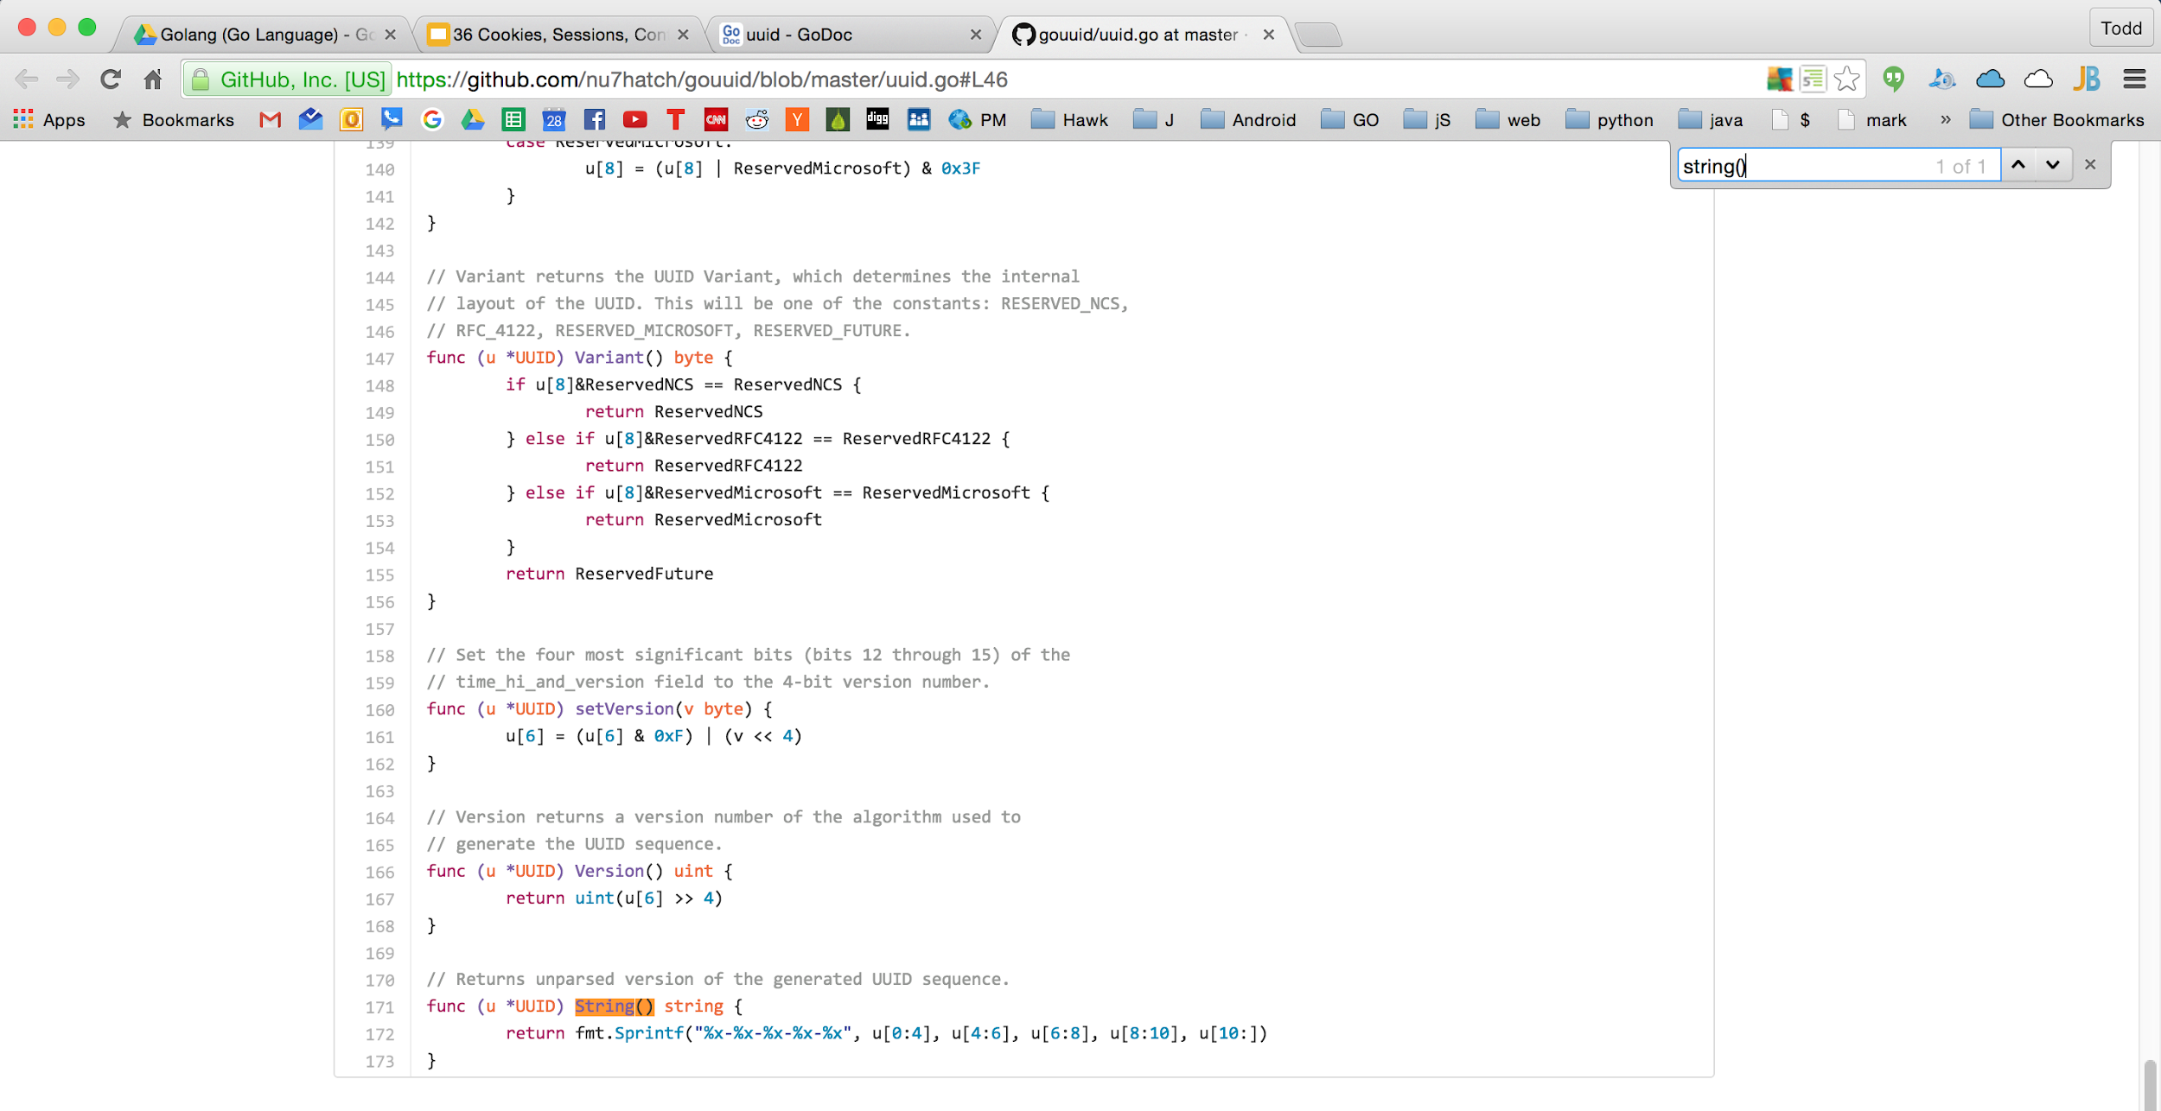

Slide 25
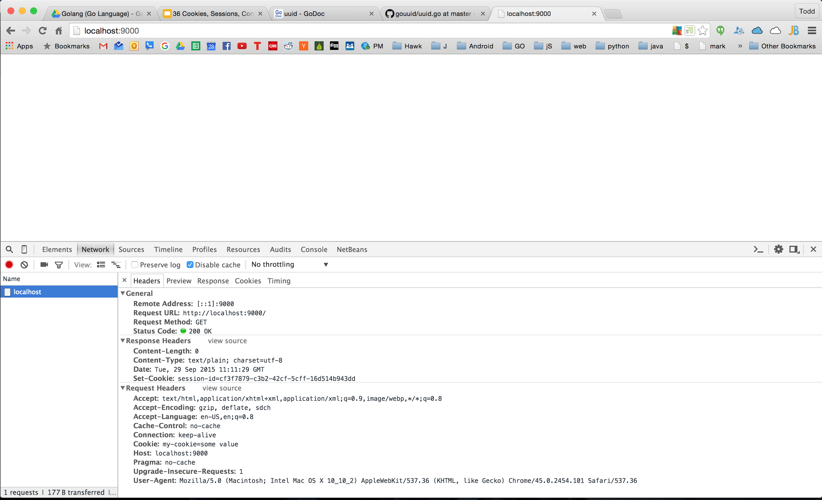

Slide 26
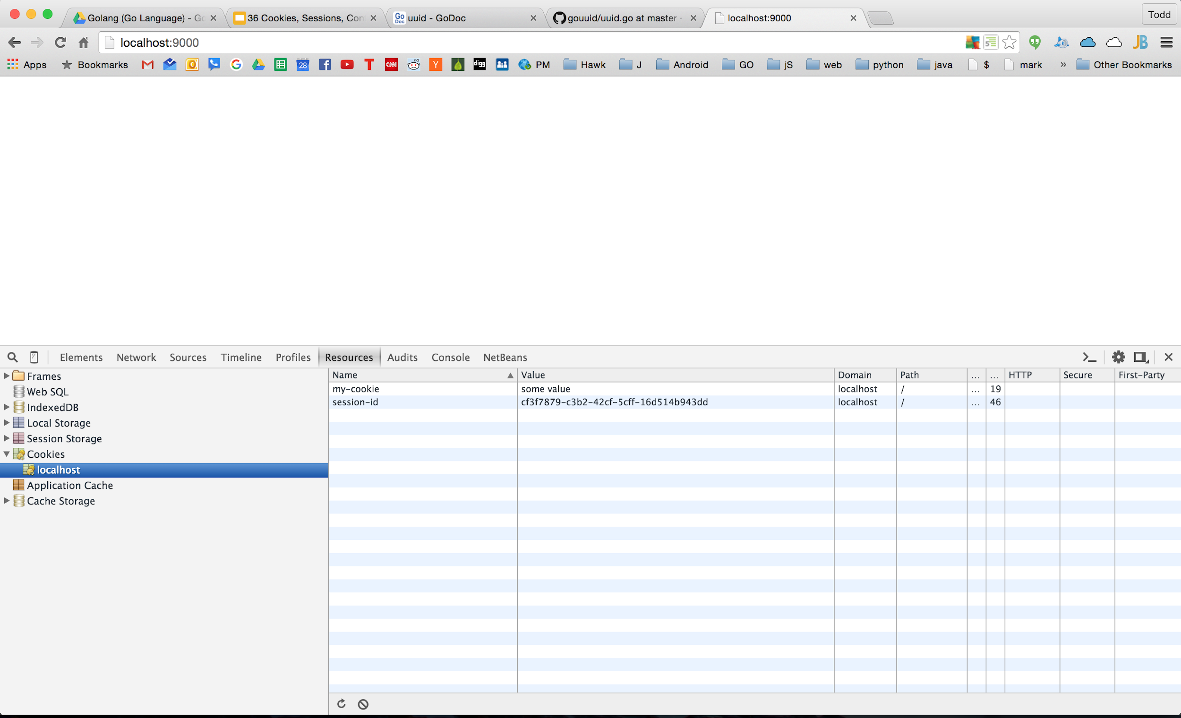

Slide 27
Cookies, Sessions, UUIDs
If you refresh
the cookie’s value remains the same
If you delete the cookie
you get a new UUID
To log a user out
delete the cookie

Slide 28
sessions
storing other info in the cookie

Slide 29
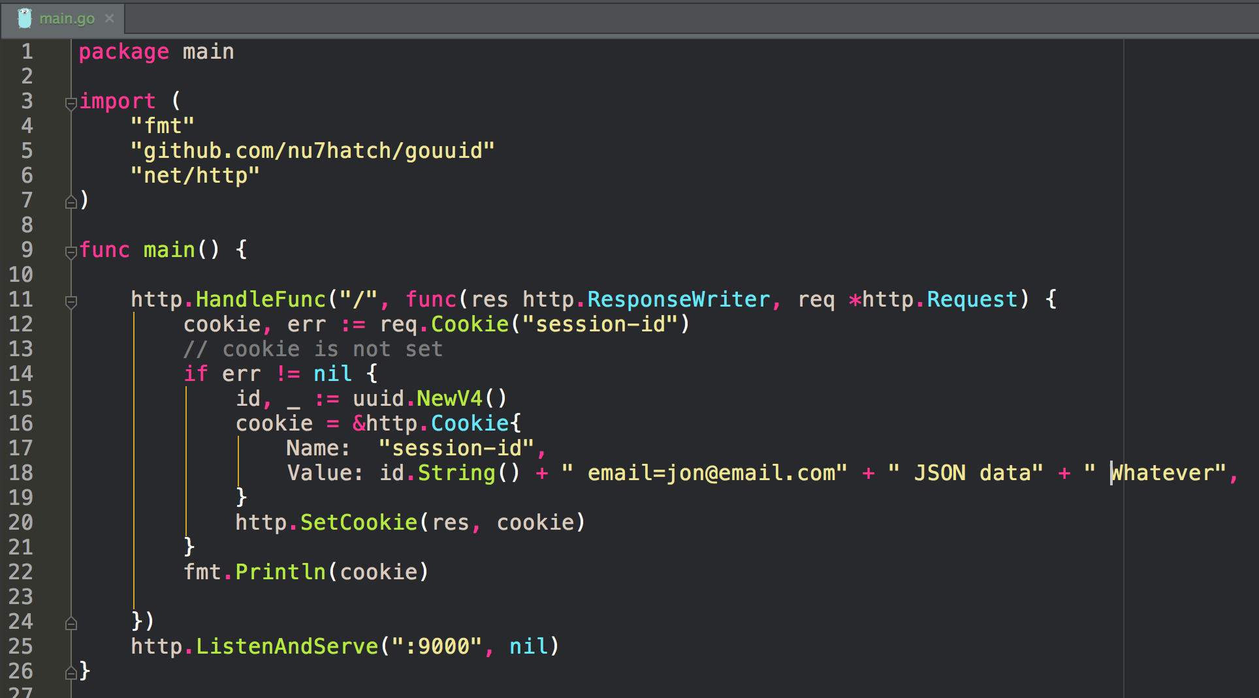

Slide 30
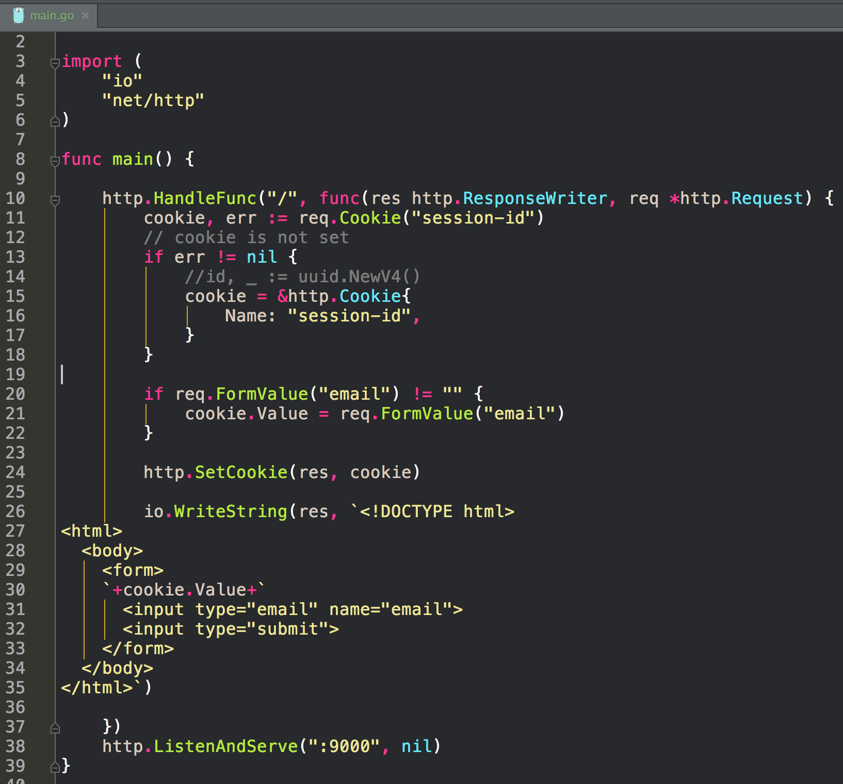
An example of storing user info in a cookie
note: no UUID used here

Slide 31
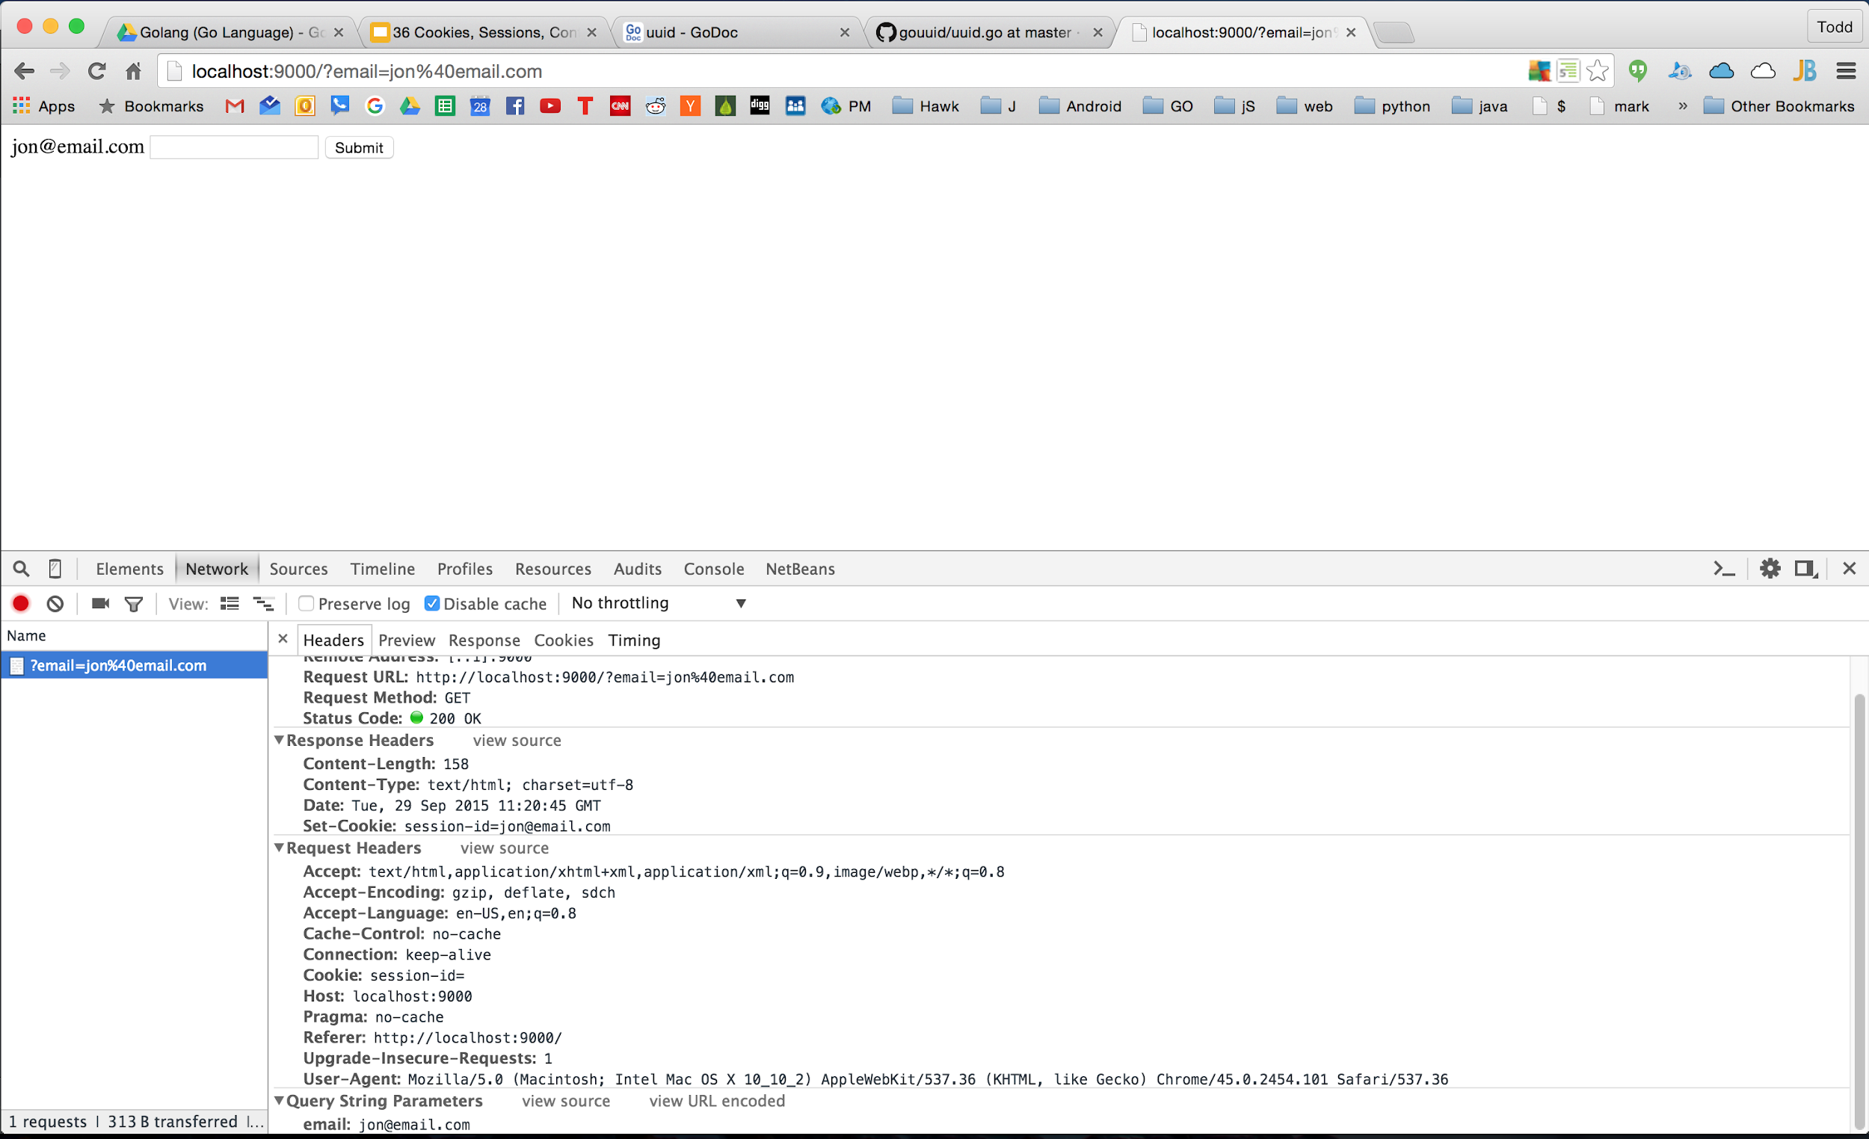

Slide 32
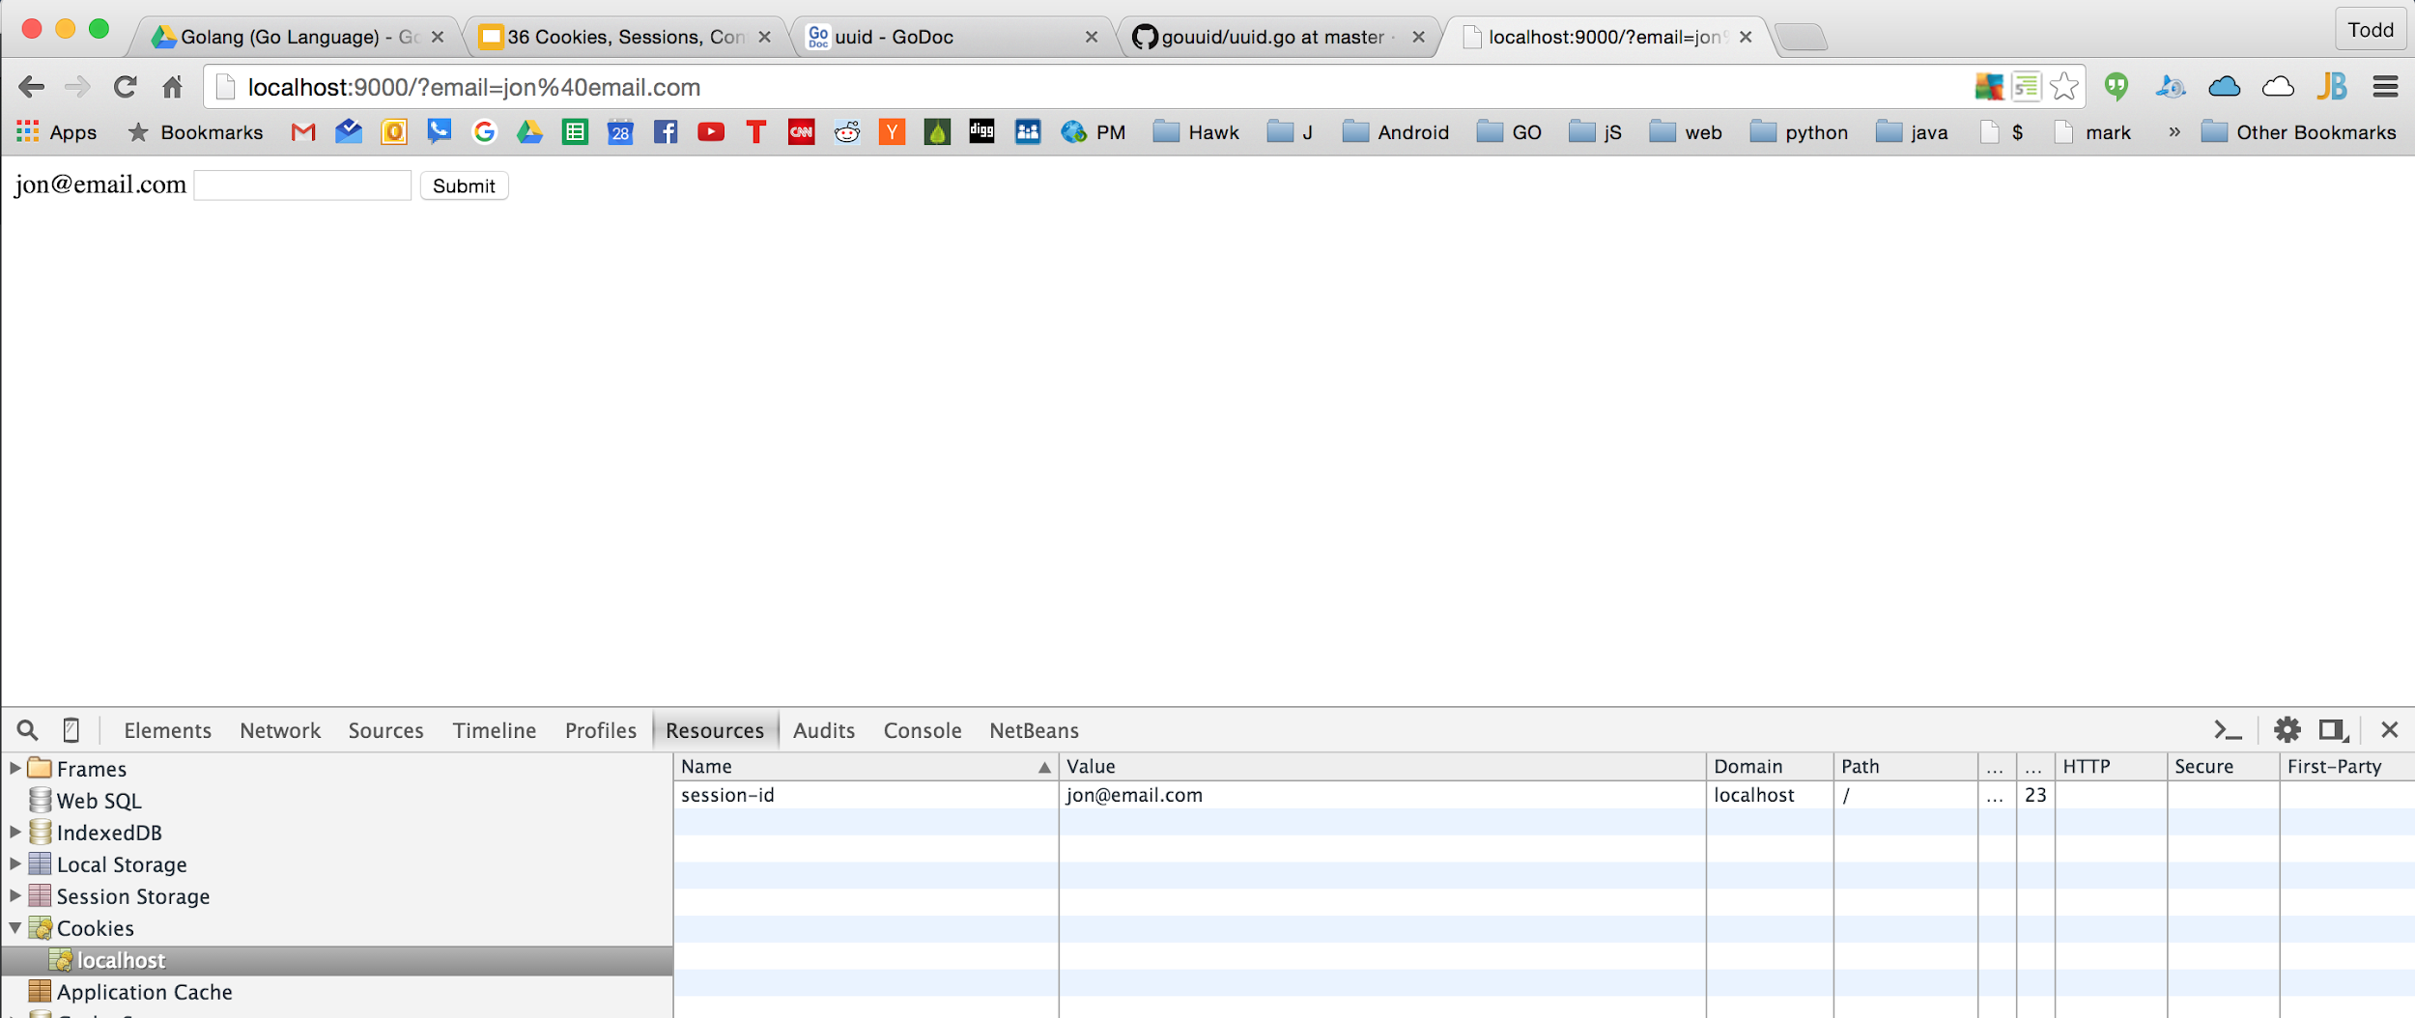

Slide 33
sessions
HMAC ~ Hash-based Message Authentication Code

Slide 34
Downside of Cookies
User can change the content
you can’t trust the content
We can protect against this with HMAC
HMAC - Hash Based Message Authentication Code
prevents cookie tampering
Go has a fantastic crypto library

Slide 35
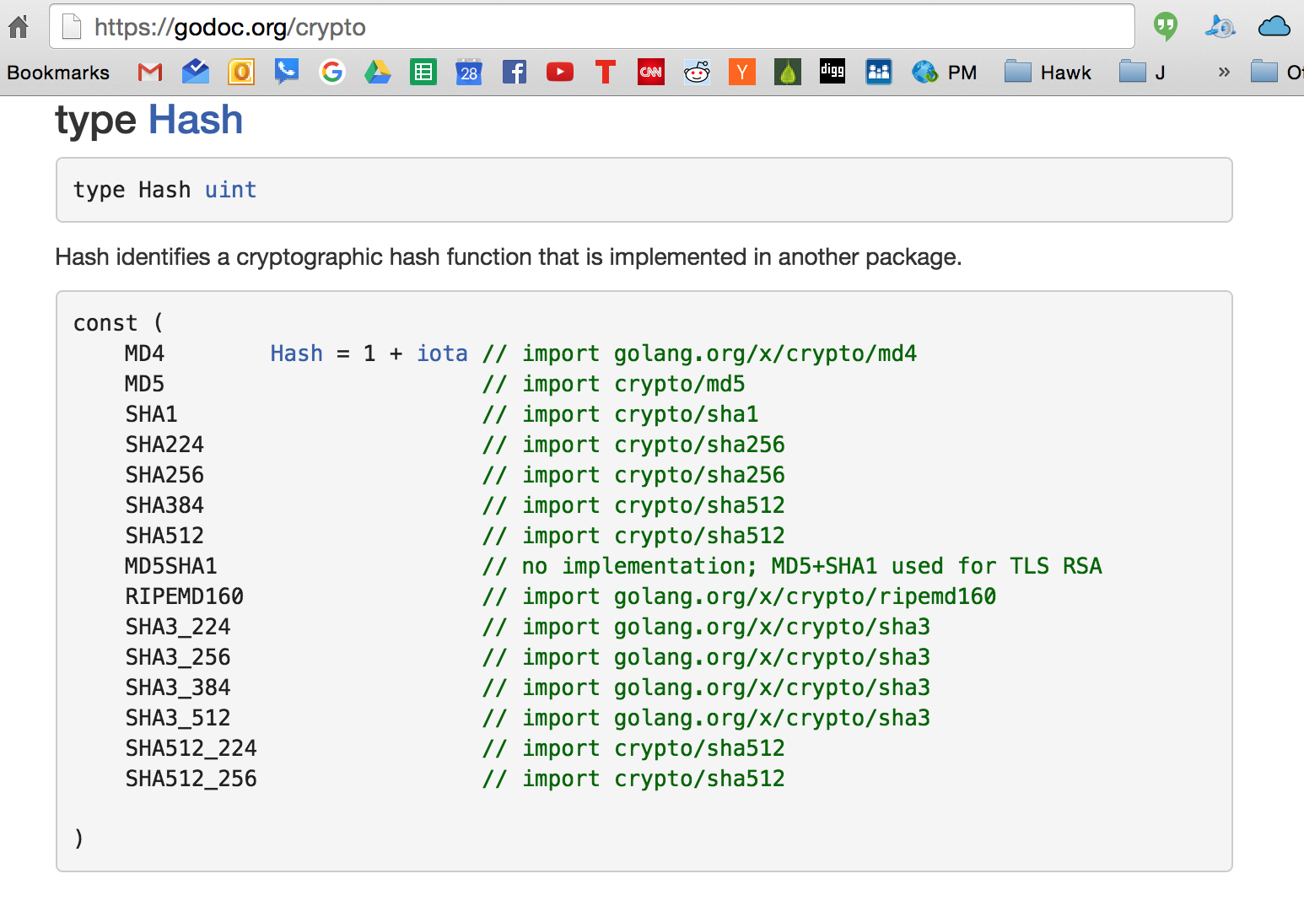

Slide 36
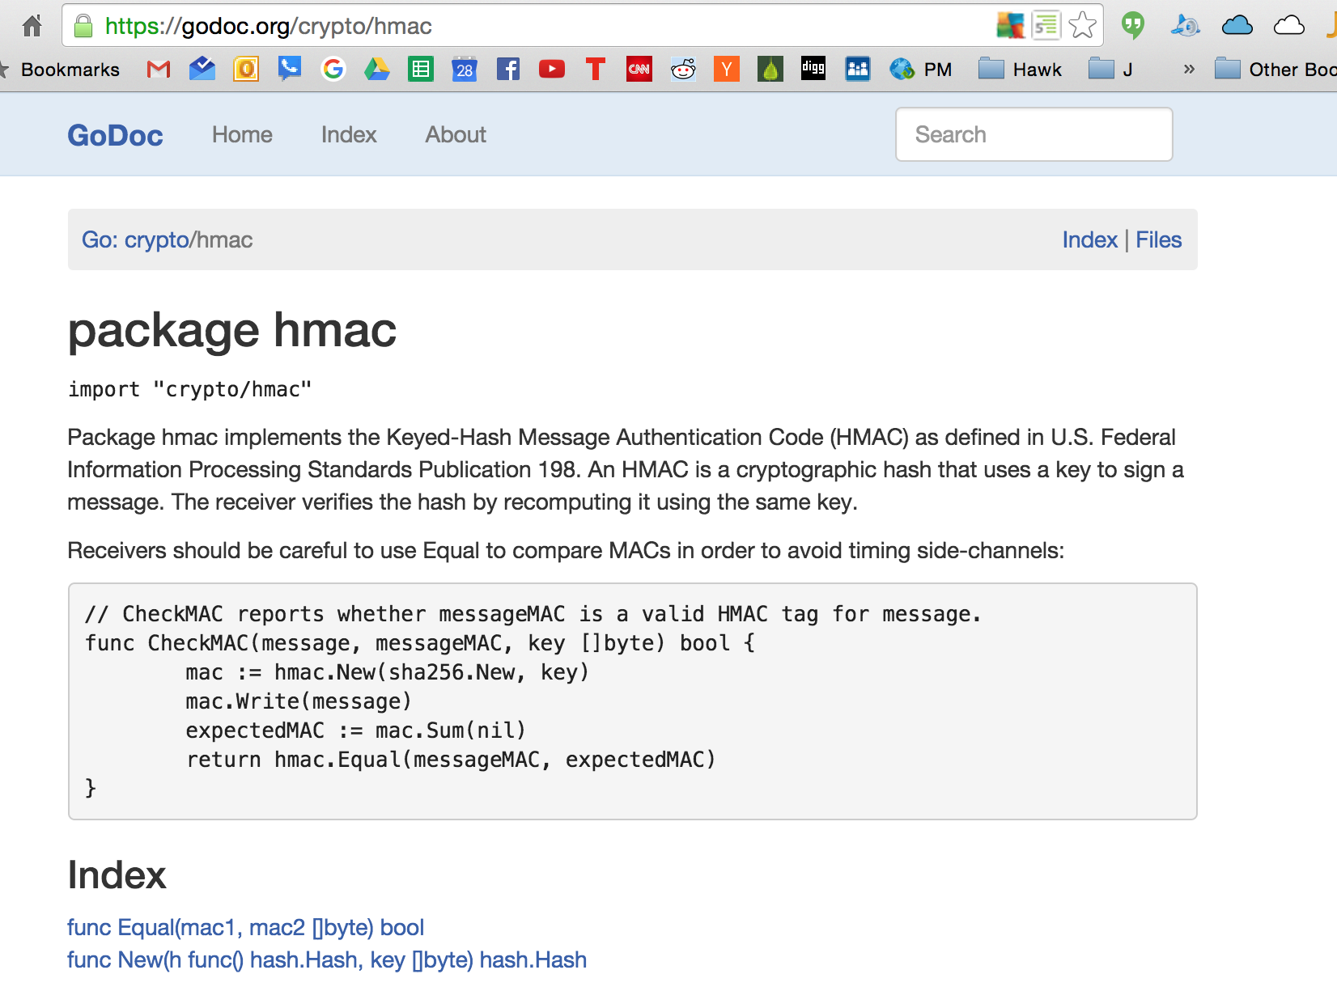

Slide 37
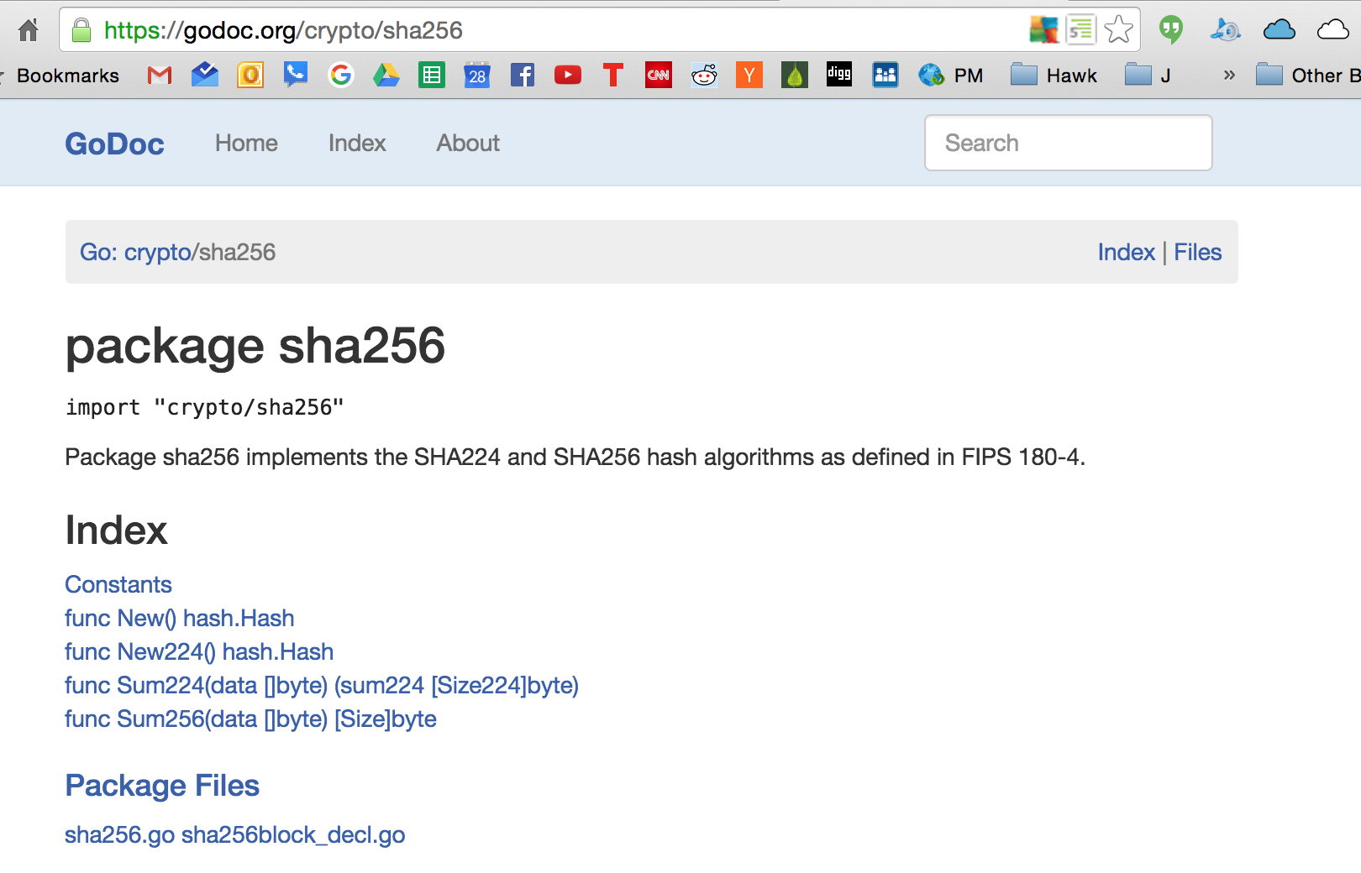

Slide 38
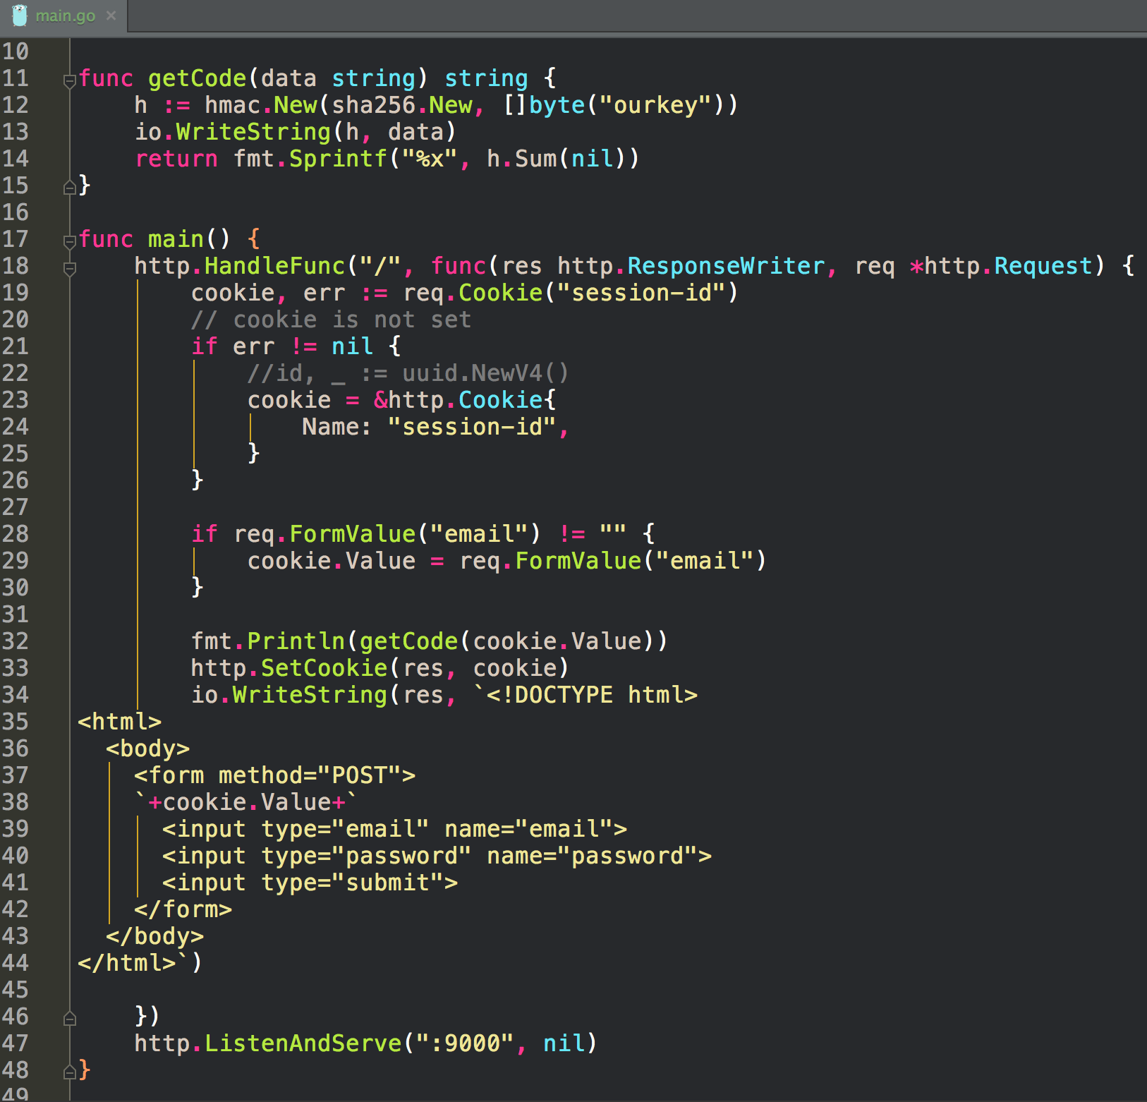
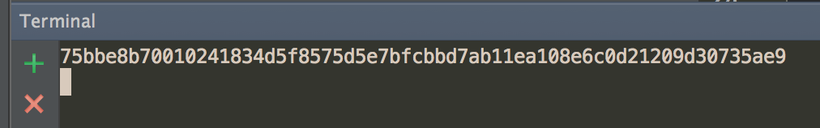

Slide 39
HMAC
When a cookie comes in on a request
we can verify it hasn’t been tampered with
this gets complicated quickly
we can use prebuilt session libraries instead
gorilla sessions

Slide 40
sessions
gorilla sessions

Slide 41
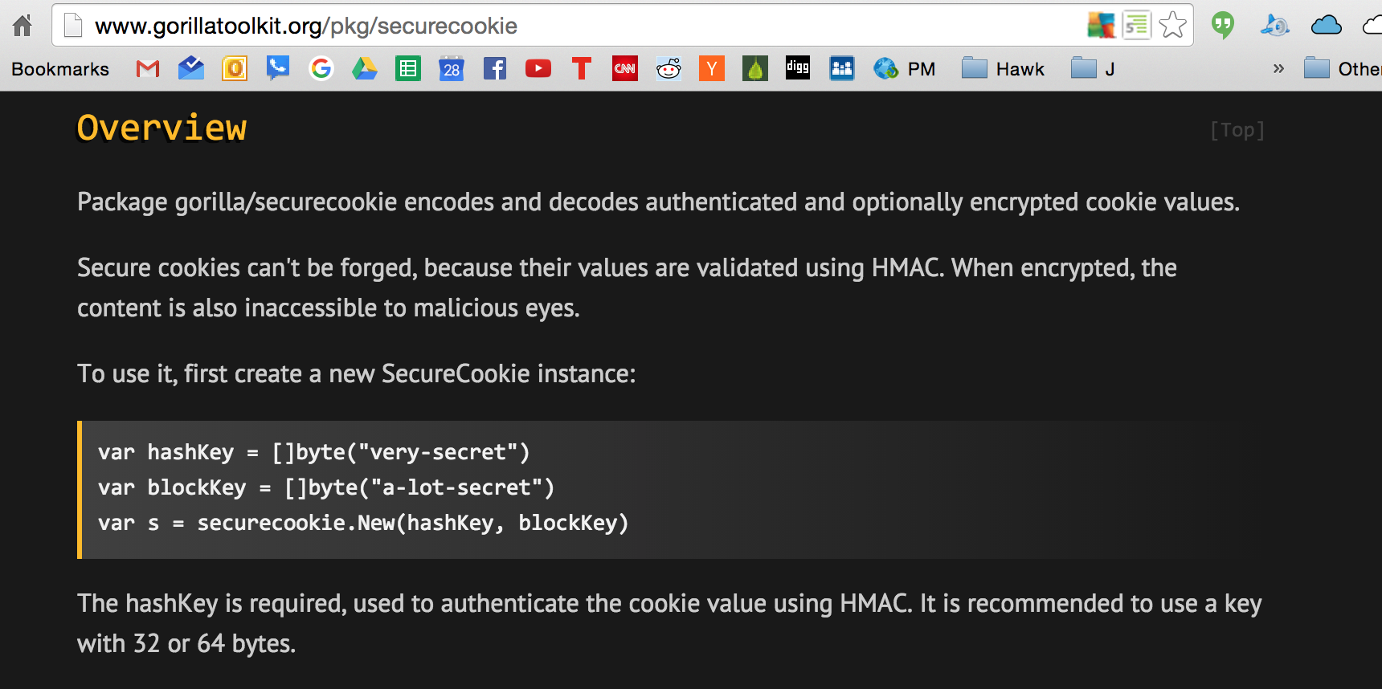

Slide 42
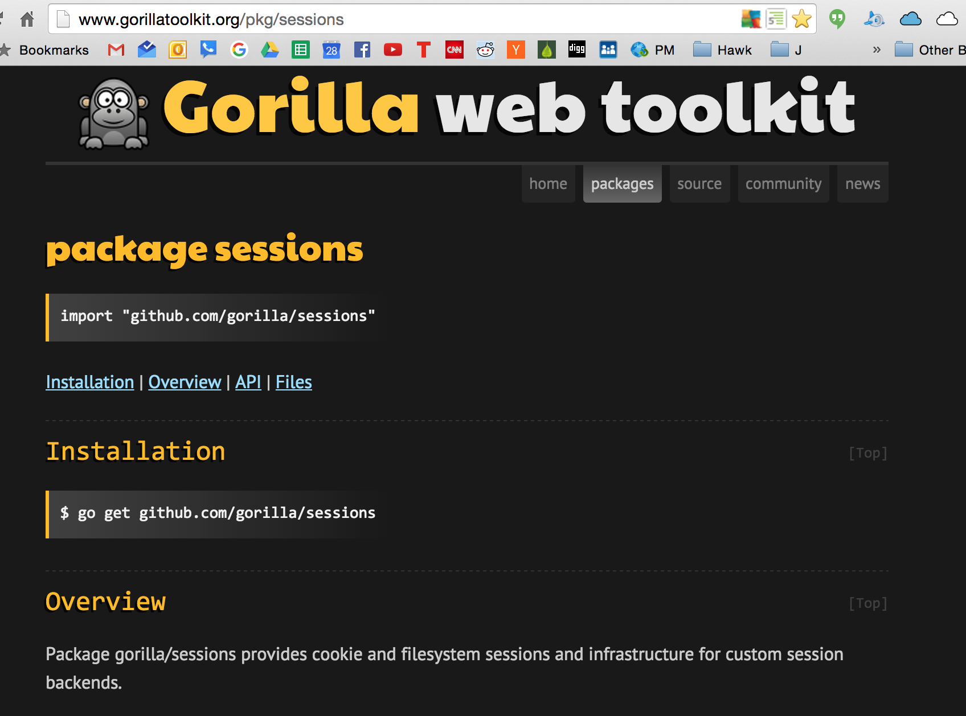

Slide 43
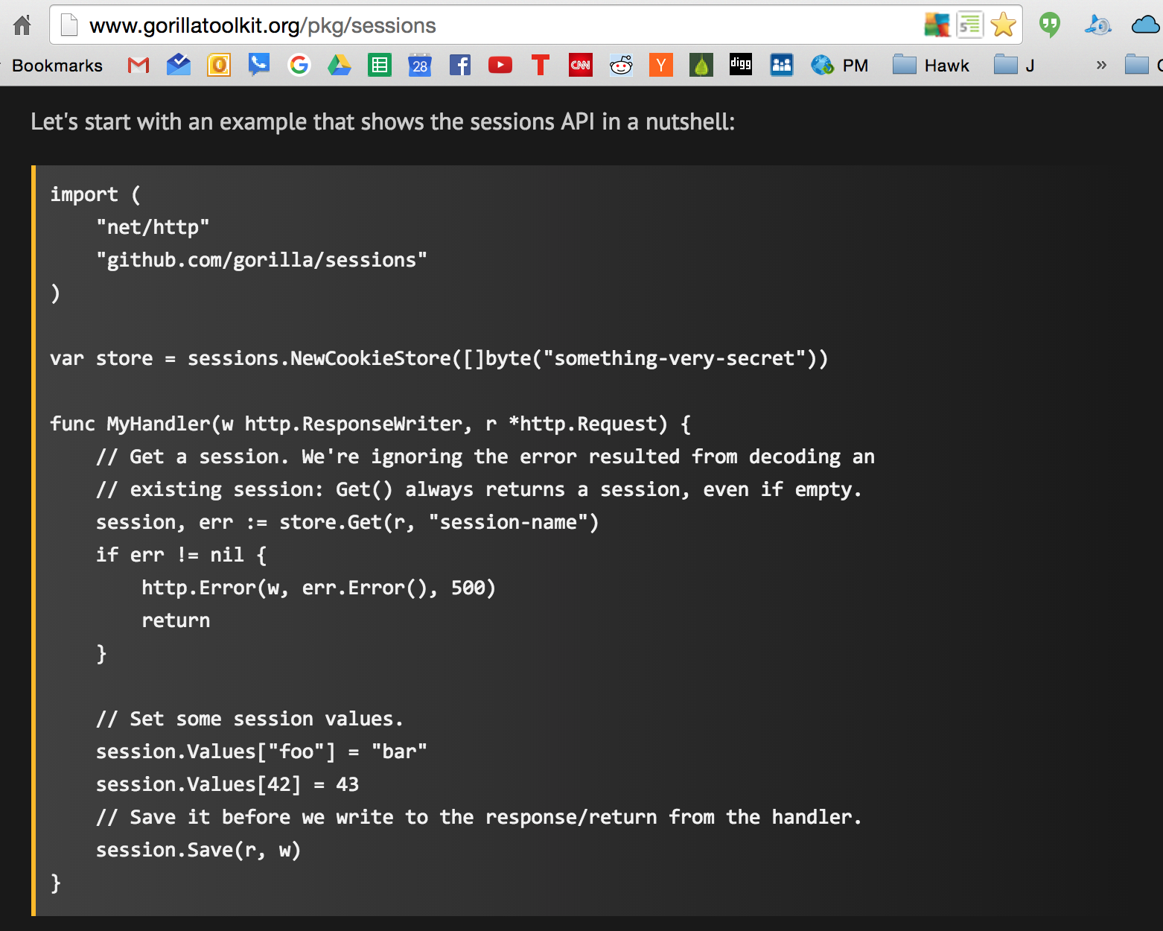

Slide 44
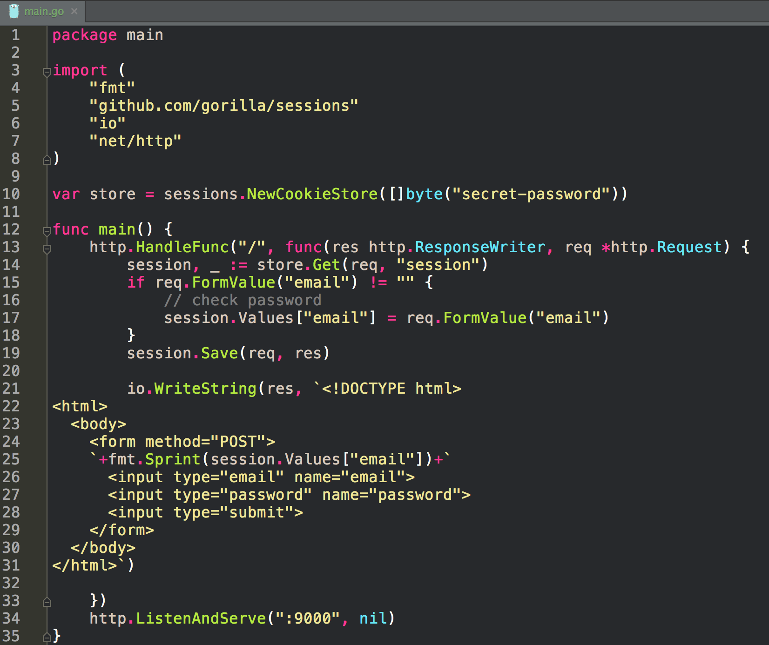
We can now create sessions: we store session.values and get session.values; being able to store email or user ID allows us to create a session for a user

Slide 45
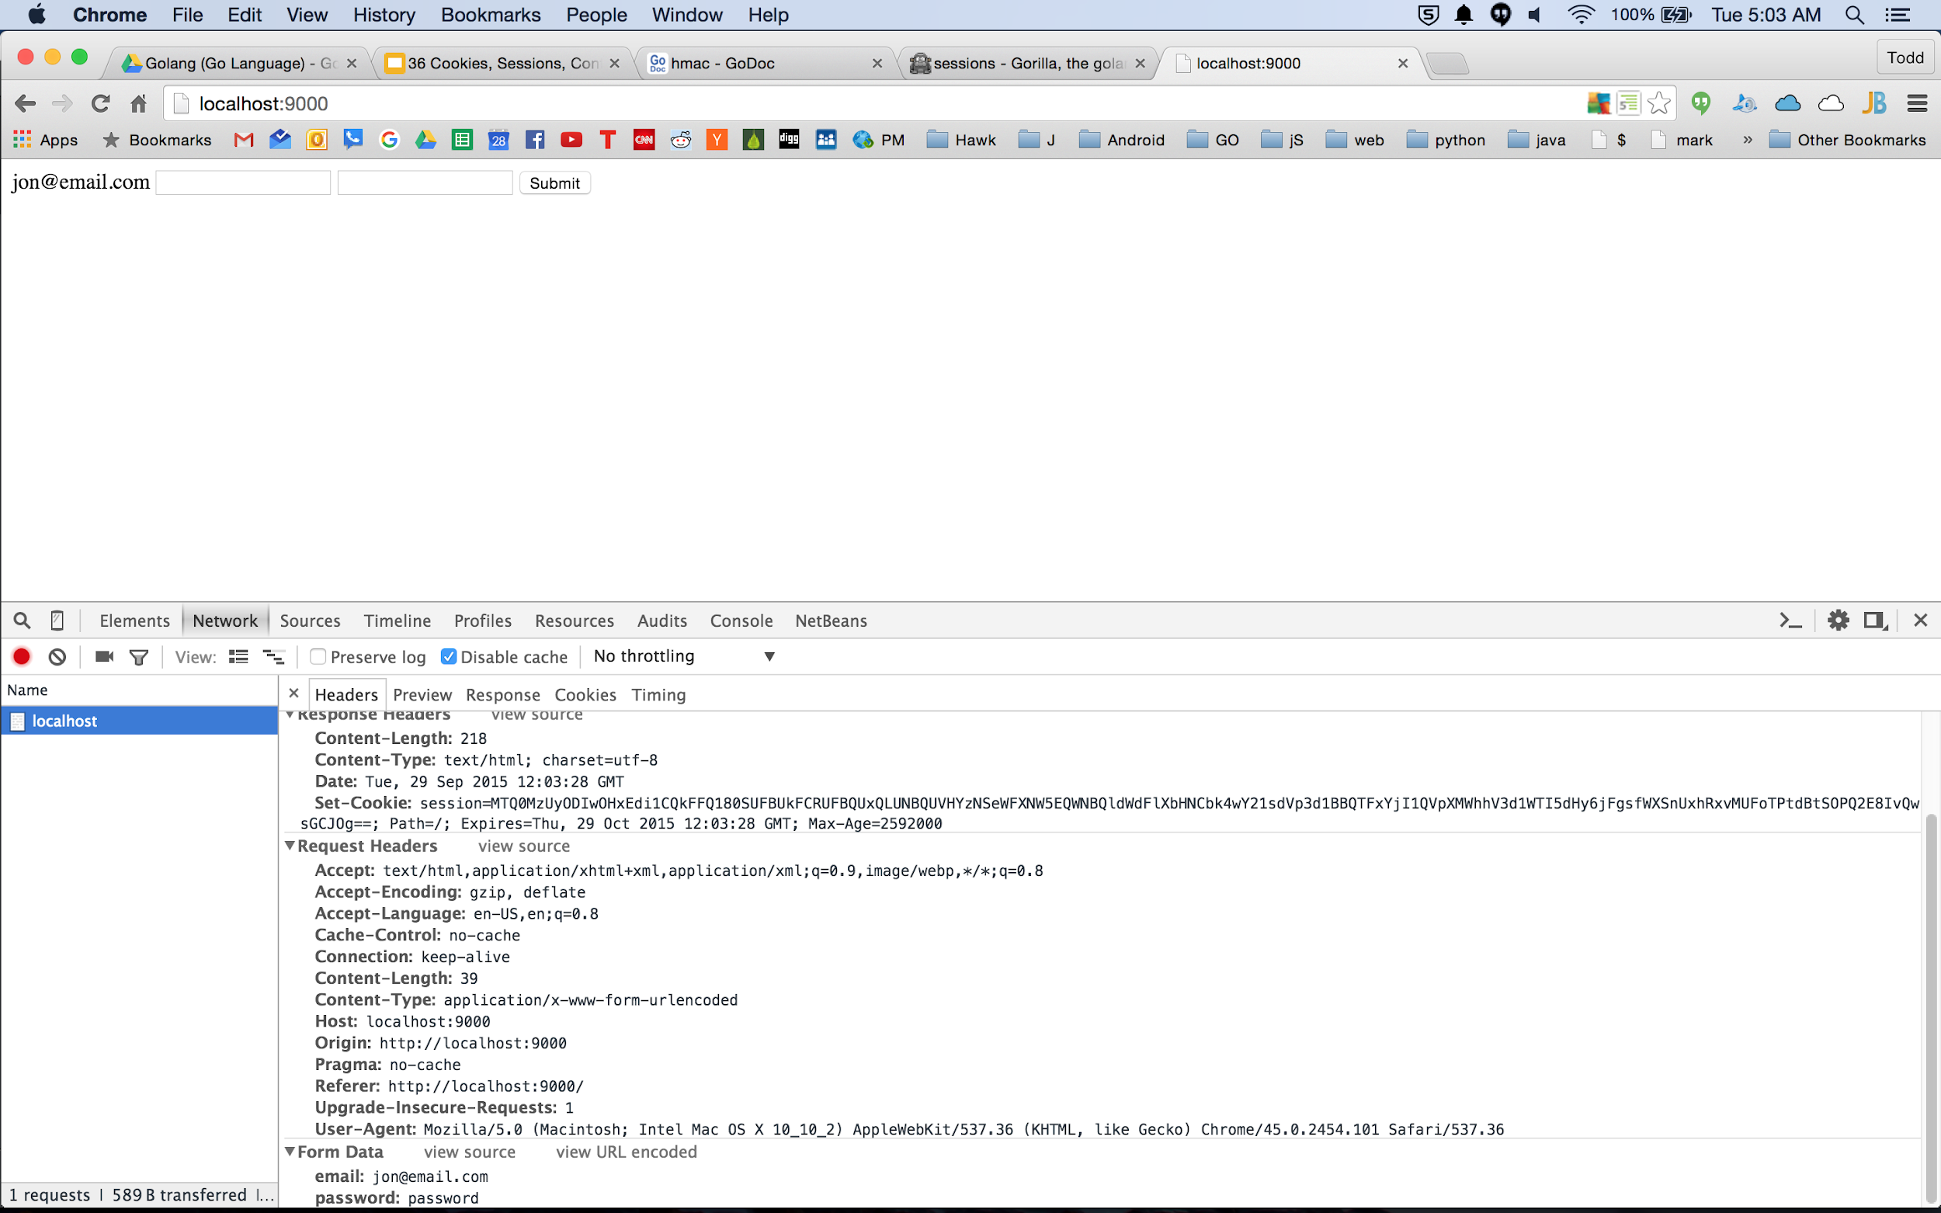

Slide 46
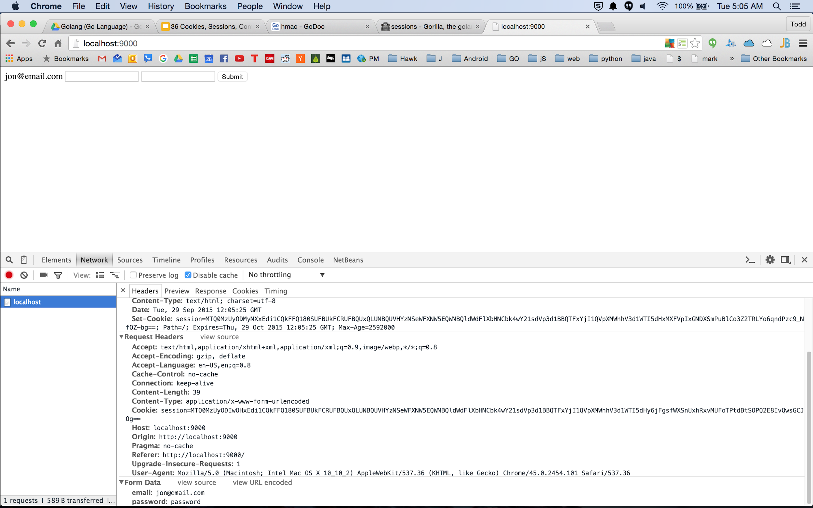
after a second request

Slide 47
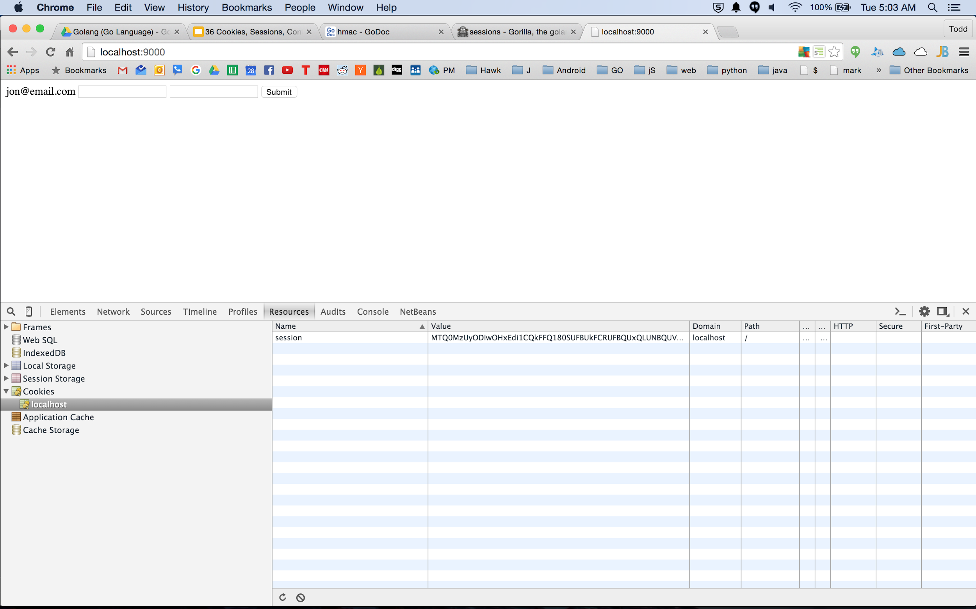

Slide 48
exercises

Slide 49
Cookies
Create an http application that tracks how many times a user accesses your web page with a cookie.

Slide 50
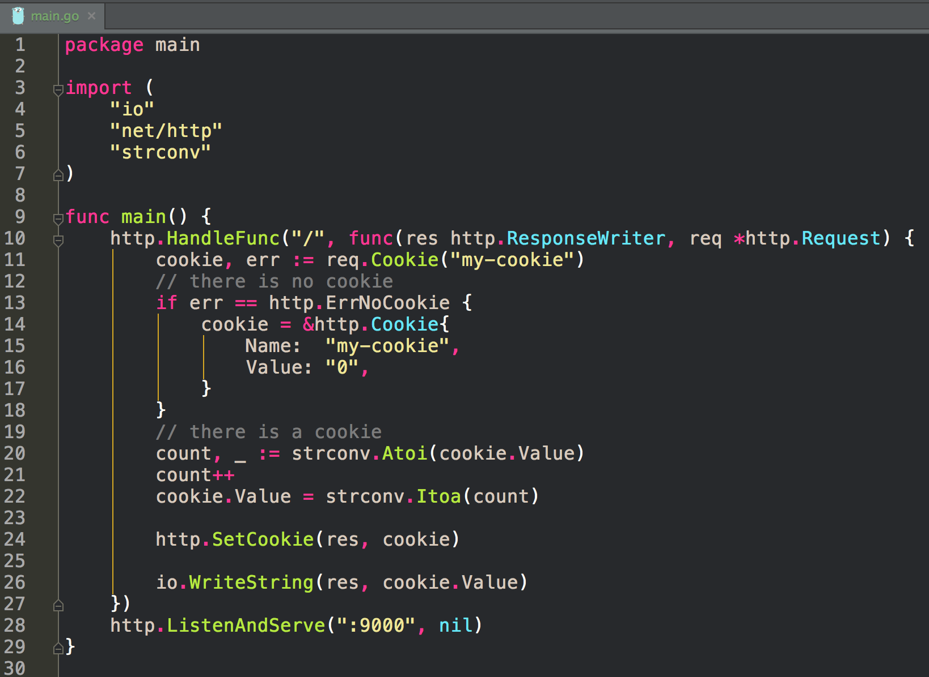

Slide 51
Sessions
Create an http application that supports at least 2 endpoints: login and logout.
login should accept a form and save a cookie. (with at least the username)
logout should clear the cookie

Slide 52
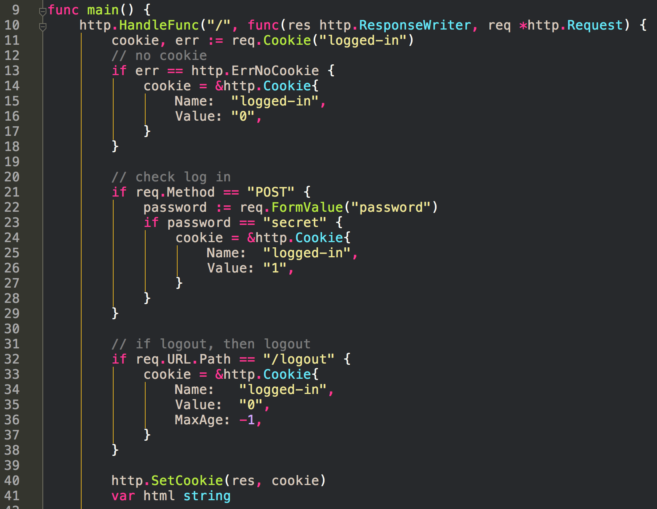
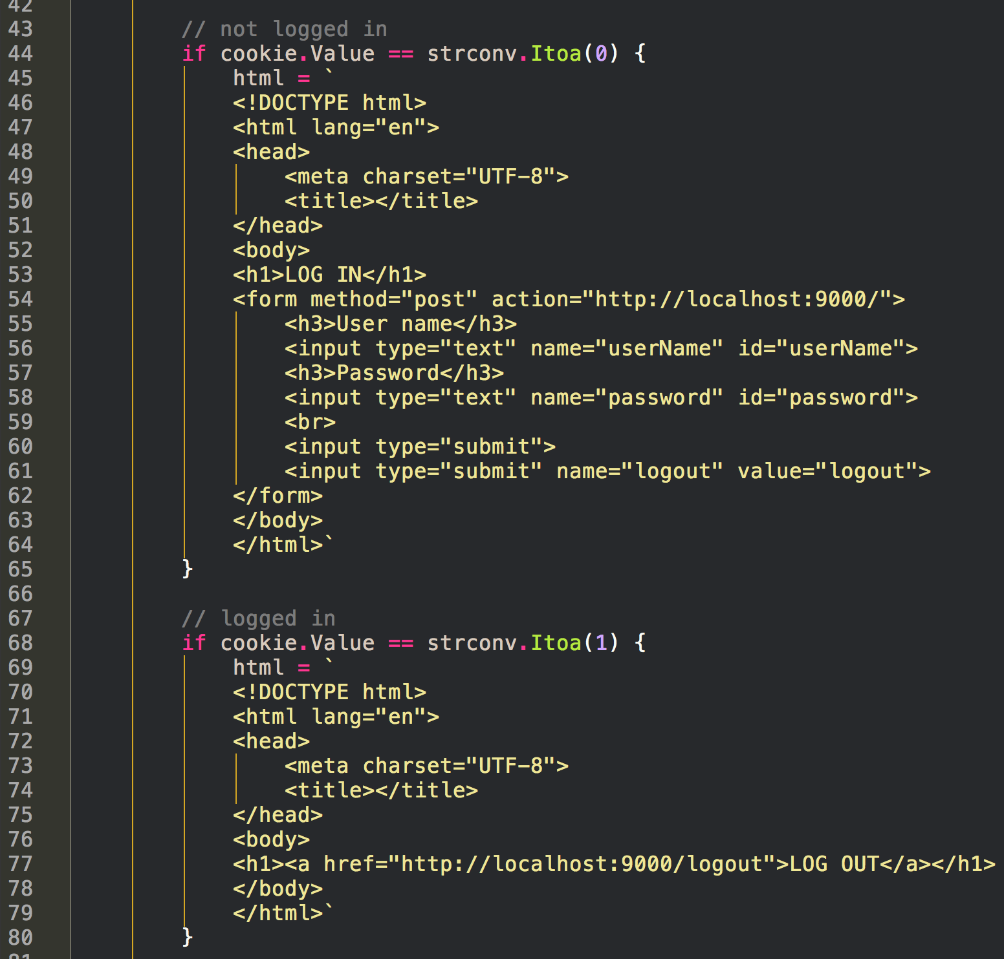
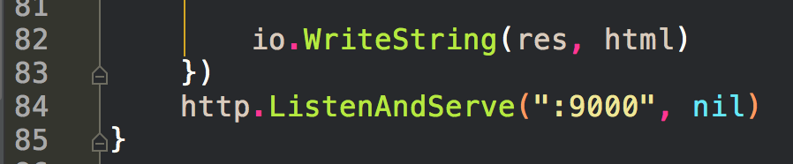

Slide 53
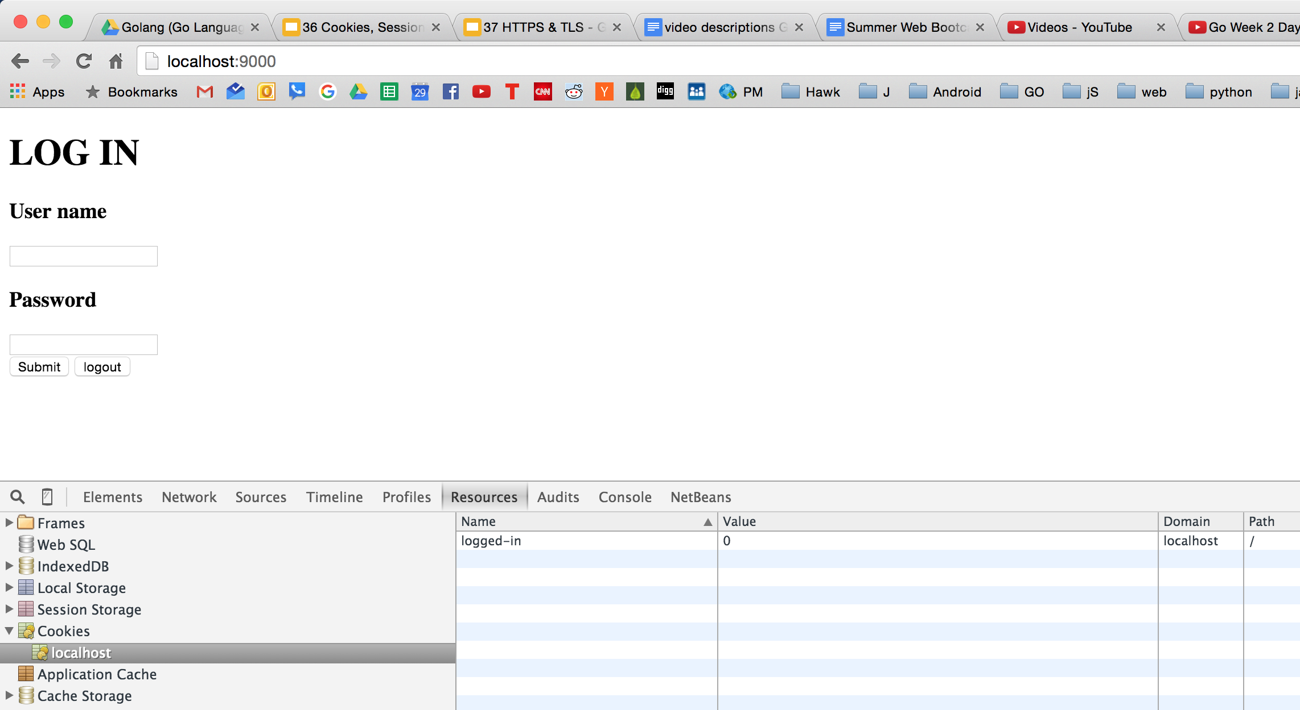

Slide 54
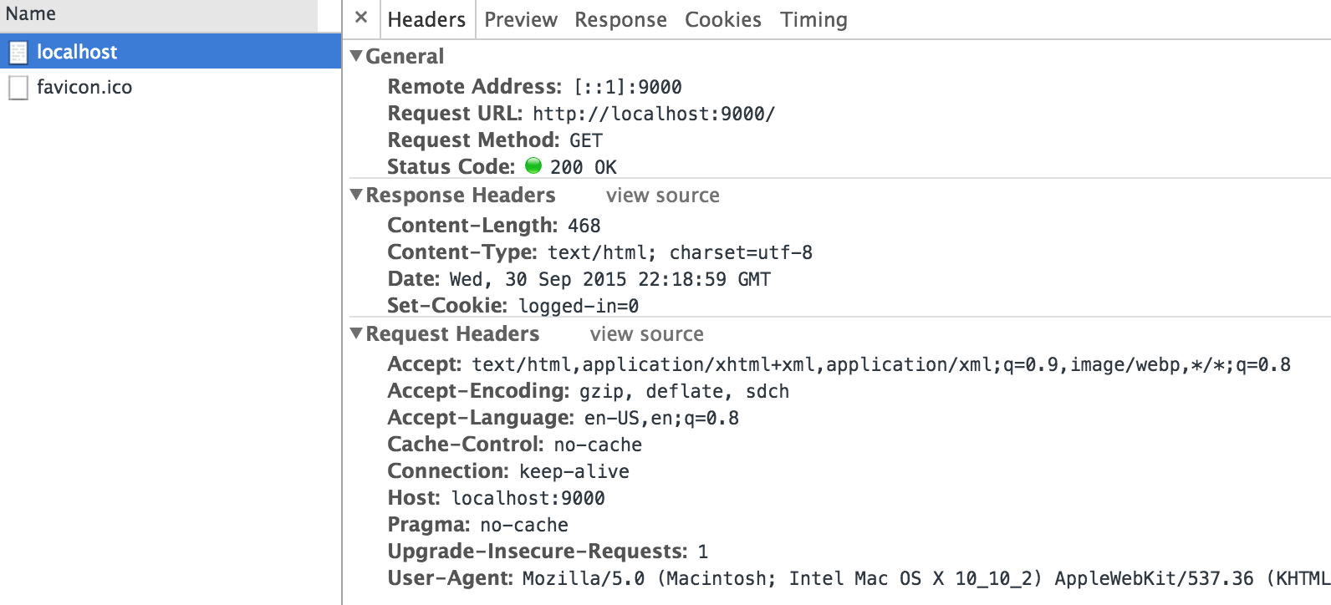

Slide 55
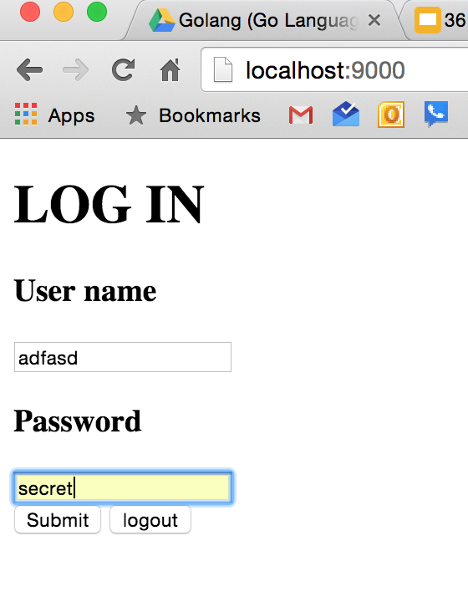

Slide 56
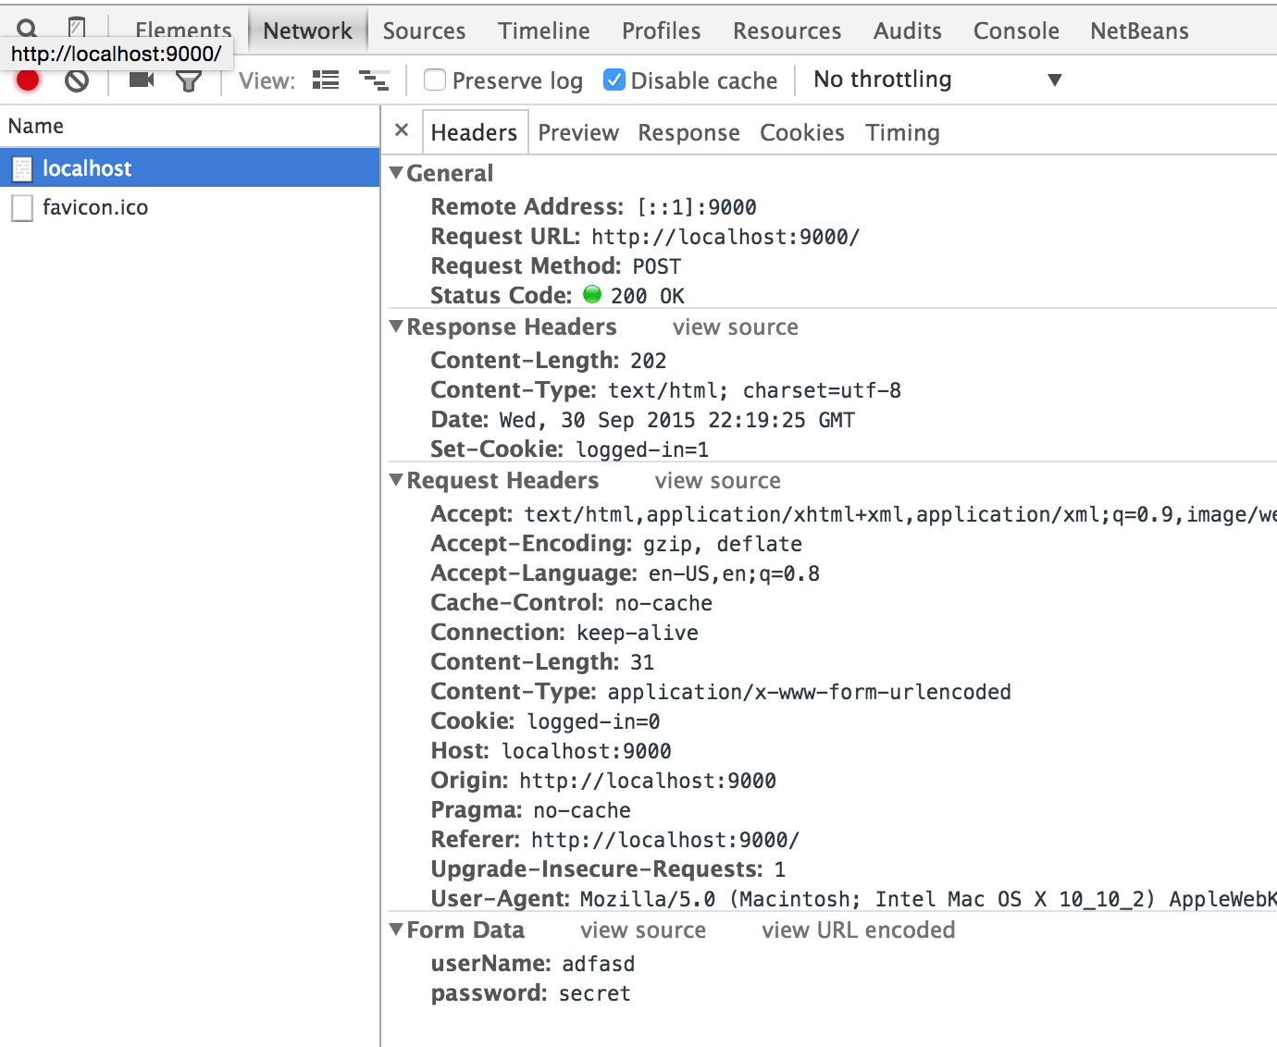

Slide 57
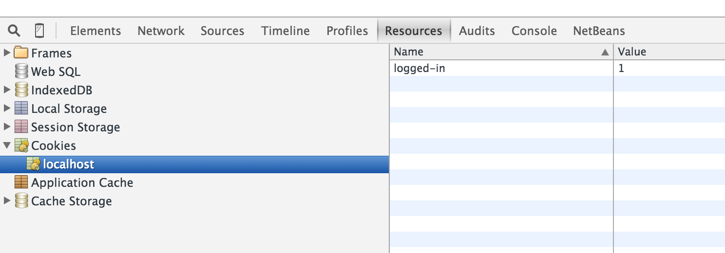

Slide 58
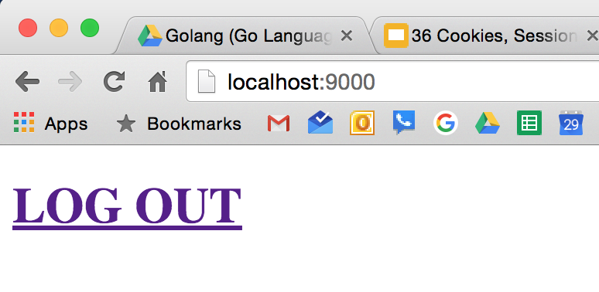

Slide 59
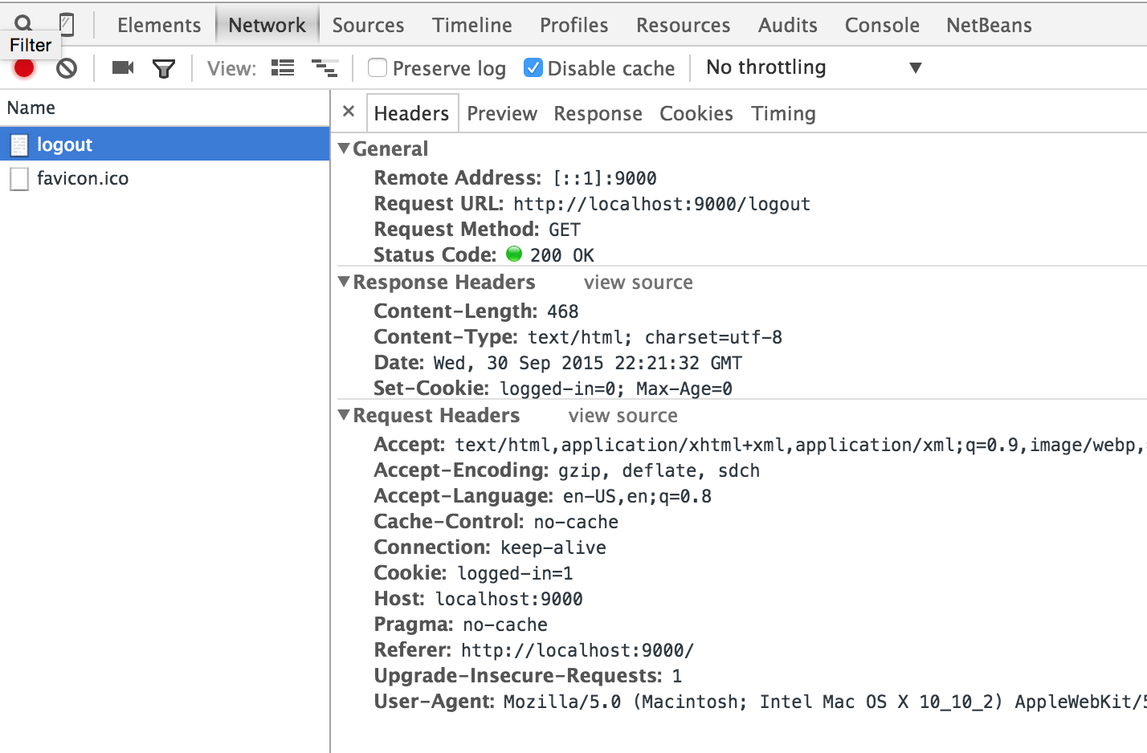

Slide 60
